Slide 1
THE FUTURE OF BREATH TESTING TECHNOLOGY
January 22, 2013

Slide 2
ABOUT ACS
Contents
ALCOHOL COUNTERMEASURE SYSTEMS
International group of companies
Established to create a technological solution to prevent drink driving
Inventor of the ALCOLOCK™ alcohol interlock for road traffic safety
Leading manufacturer of breath alcohol testing instruments
Privately held, consistently profitable
Committed to research and development
International reputation for excellence
Quality management hallmark
ISO 9001, ISO 14001 and TS 16949 certified
Felix J E Comeau
Chairman & CEO

Slide 3
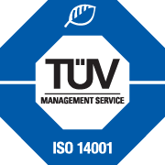
ISO STANDARDS
ISO 9001:2008
ISO 14001:2004
ISO/TS 16949:2009
This international standard specifies criterion for a quality management system in which an organization must demonstrate its ability to consistently provide product that meets customer, statutory and regulatory requirements.
This international standard specifies legal requirements and guidelines to enable an organization to develop and implement environmental policies and objectives.
This international standard and technical specification defines quality management system requirements. Its focus lies on continually improving defect prevention and reducing variation and waste in the supply chain.

Slide 4
ALCOHOL INTERLOCK HISTORY
1980 – 1990:
Convicted drink drivers become first alcohol interlock clients
1990 – 2000:
Alcohol interlocks made available for proactive consumers
2000 – 2010:
Alcohol interlocks available for factory installation via major vehicle manufacturers
2010 – 2020:
Alcohol interlocks factory installed in every new car in Sweden and every bus transporting children in France

Slide 5
OUR MARKETS
An international objective met through regional focus
ACS has offices around the globe, immersed in the judicial climate of every region. We are able to offer internationally recognized manufacturing quality while quickly meeting customer service needs and tailoring programs at the local level.

Slide 6
ALCOLOCK™ V3
INTENDED MARKET
Automotive OEM Market, Vehicle Fleets, Automotive Safety
INFORMATION
The ALCOLOCK V3 alcohol interlock measures the breath alcohol concentration (BrAC) of a driver and prevents the vehicle from starting if the driver’s BrAC is over a preset limit. Its durable construction ensure reliability in all the environments such as trucks, ships, and heavy machinery.

Slide 7
BAR GRAPH TITLE

Slide 8
PIE CHART TITLE

Slide 9
TITLE
Text goes here.
Name
Row 1
Row 2
Row 3
Row 4
Row 5
Row 6
Row 7

Slide 10
MULTIPLE IMAGES LAYOUT

Slide 11
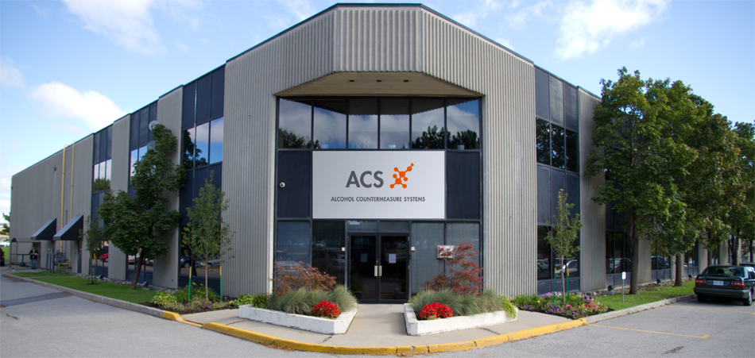
CONTACT US
Customer service is supported from our Canadian headquarters and through our satellite offices in Australia, Europe, Asia and the USA.
For more information please visit: acs-corp.com
INTERNATIONAL HEADQUARTERS
60 International Boulevard
Toronto, Ontario M9W 6J2
CANADA
PHONE
+1 416 619 3500
INFORMATION
Alcohol Countermeasure Systems (ACS) is a leading manufacturer of alcohol interlocks and breath alcohol testers. ACS produces some of the most accurate and reliable alcohol sensing equipment available in the industry.
For more information about ACS, ALCOLOCK technology and its applications, please visit acs-corp.com

Slide 12
SAFETY. IN THE PALM OF YOUR HAND.
Notice of Proprietary Rights and Copyrights
This presentation contains Confidential Information. It is solely and exclusively the property of Alcohol Countermeasure Systems Corp, and may not be reproduced or otherwise used, in whole or in part, without the express written permission of the company.
ALCOCHECK, ALCOHOL COUNTERMEASURE SYSTEMS, ALCOLAB, ALCOLOCK,ALCOSIM, ALCOSCAN, ALERT, DRIVESAFE, Saf’IR and The Molly Logo are trademarks of Alcohol Countermeasure Systems (International) Inc., and are used under license.
For more information please visit acs-corp.com

