Slide 1

PRODUCT PRESENTATION 2018

Slide 2

Alcohol Interlocks

Slide 3
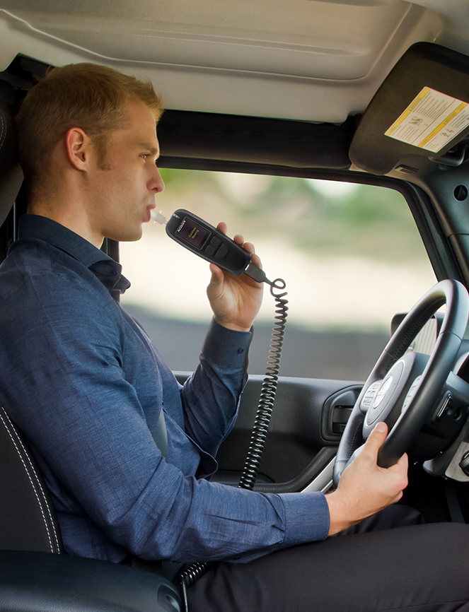

Compliance Alcohol Interlocks

Slide 4
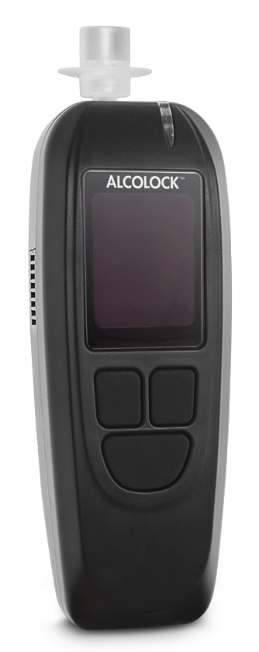

Compliance Alcohol Interlock
Designed for compliance programs for drink driving offenders
Prevents vehicle from starting unless the driver provides a breath sample below the limit
Records event data for secure transmission to authorities
Tamper-resistant to comply with international performance standards
Optional wireless communication:
Wi-Fi, GPRS, GPS
Optional integration with FOCUS camera for driver identification
4
Notes:
ALCOLOCK LR alcohol interlock is designed for compliance programs for drink driving offenders and prevents a vehicle from being started unless the driver provides an accepted breath sample with an alcohol concentration below the pre-set limit.
ALCOLOCK LR records event data from each breath test and enables secure transmission to a central server for reporting to jurisdictional authorities. It may also be integrated with the FOCUS camera for driver identification.
ALCOLOCK LR provides ease of use while preventing tampering to comply with international performance standards, and features optional wireless communication through Wi-Fi or GPRS, and GPS coordinates for the recorded event data.

Slide 5
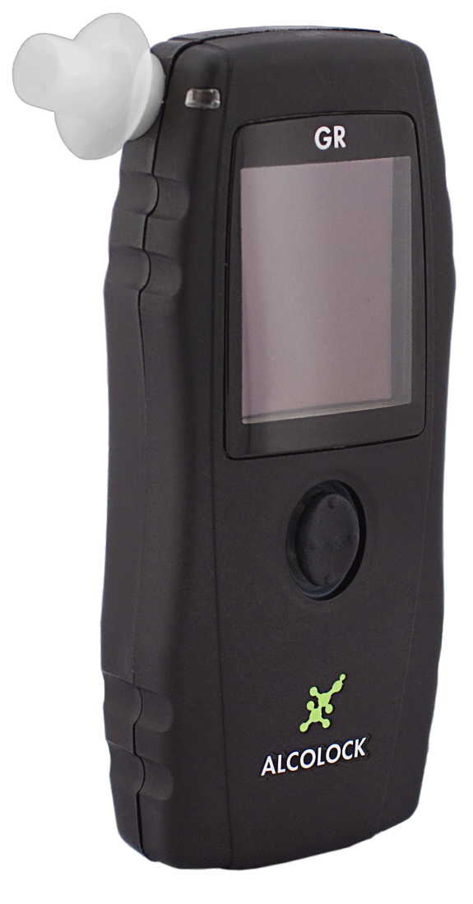
Compliance Alcohol Interlock
Designed for compliance programs for drink driving offenders
Prevents vehicle from starting unless the driver provides a breath sample below the limit
Records event data for secure transmission to authorities
Tamper-resistant to comply with international performance standards
Wired or wireless operation
5
Notes:
ALCOLOCK GR alcohol interlock is designed for compliance programs for drink driving offenders and prevents a vehicle from being started unless the driver provides an accepted breath sample with an alcohol concentration below the pre-set limit.
ALCOLOCK GR records event data from each breath test and enables secure transmission to a central server for reporting to jurisdictional authorities.
ALCOLOCK GR provides ease of use while preventing tampering to comply with international performance standards, and features optional wireless communication through Wi-Fi or GPRS, and GPS coordinates for the recorded event data.

Slide 6
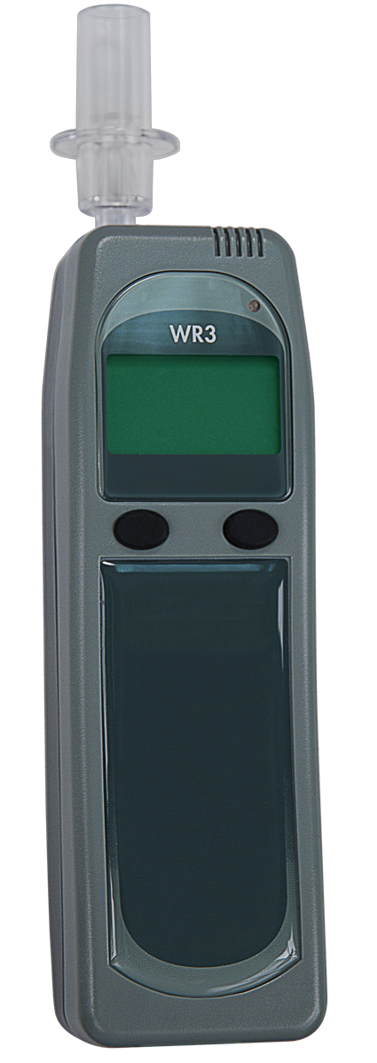
Compliance Alcohol Interlock
Designed for compliance programs for drink driving offenders
Prevents vehicle from starting unless the driver provides a breath sample below the limit
Records event data for secure transmission to authorities
Tamper-resistant to comply with international performance standards
6
Notes:
ALCOLOCK LR alcohol interlock is designed for compliance programs for drink driving offenders and prevents a vehicle from being started unless the driver provides an accepted breath sample with an alcohol concentration below the pre-set limit.
ALCOLOCK LR records event data from each breath test and enables secure transmission to a central server for reporting to jurisdictional authorities. It may also be integrated with the FOCUS camera for driver identification.
ALCOLOCK LR provides ease of use while preventing tampering to comply with international performance standards, and features optional wireless communication through Wi-Fi or GPRS, and GPS coordinates for the recorded event data.

Slide 7
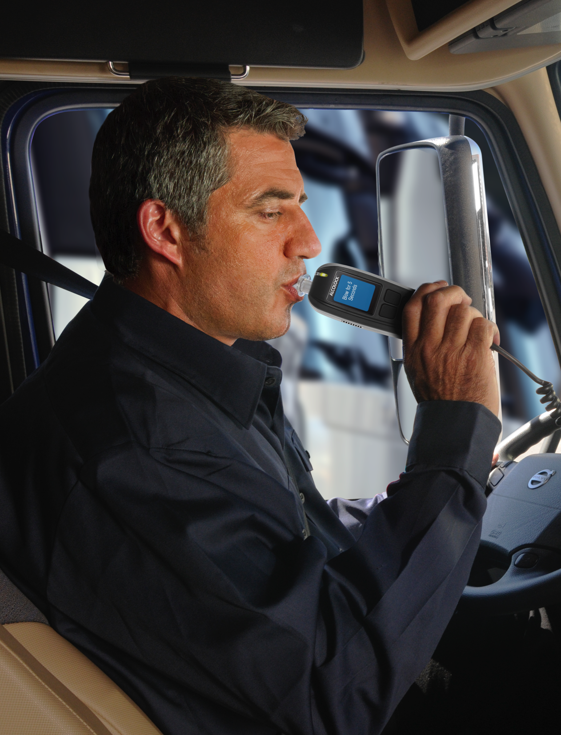
Commercial Alcohol Interlocks

Slide 8
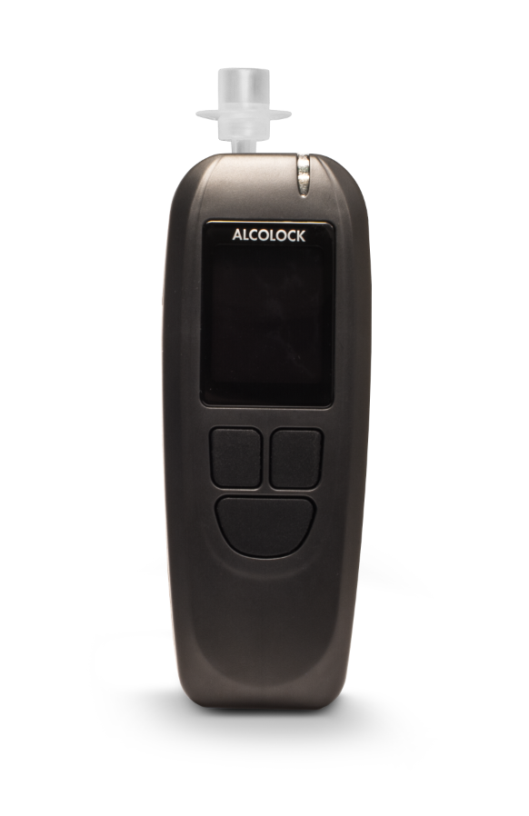
Commercial Alcohol Interlock
Range of integrated solutions for commercial vehicle management
Designed for use in:
Trucking
Coach and bus
School transportation
Public transportation
Taxi
Mining
Construction
Monitor and control vehicle use
Designed for both OEM and aftermarket installation
8
Notes:
ALCOLOCK L series of alcohol interlocks provide a range of solutions for commercial management programs.
The ALCOLOCK L series provides integrated solutions designed for use in the trucking, coach and bus, school transportation, public transportation, taxi, mining and construction industry to monitor and control the use of the vehicle.
ALCOLOCK L series are also designed for OEM installation at the factory or through service centers in the aftermarket.

Slide 9
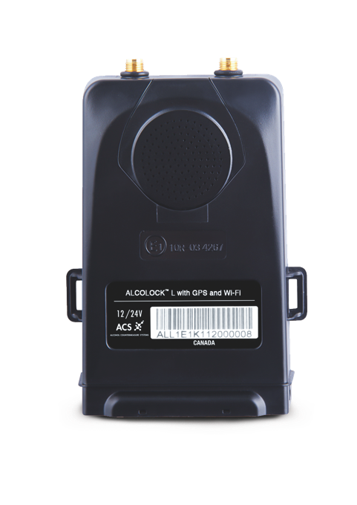
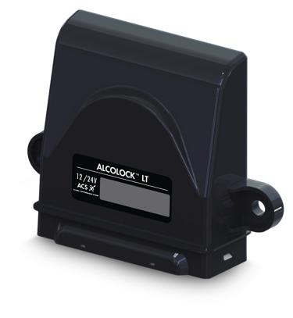
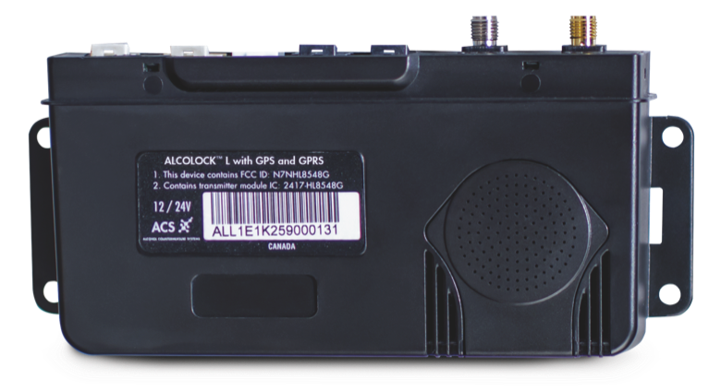
Commercial Alcohol Interlock
Electronic Control Units (ECUs) are specifically designed for commercial safety management
Full event data recording with GPS coordinates
Wireless data transmission via
Wi-Fi, GPRS or Bluetooth
Integration with telematic devices for management and oversight though ALCOFLEET
ECU variants available for diverse fleet sizes and requirements
9
Notes:
ALCOLOCK L series Electronic Control Units (ECUs) are specifically designed for commercial safety management programs.
The ALCOLOCK L series ECU enables full event data recording, integration with telematic devices, flexible program management and oversight though ALCOFLEET web services application.
They also feature wireless communications for data transmission via Wi-Fi, GPRS or Bluetooth, GPS coordinates for the recorded event data and fleet monitoring through ALCOFLEET web services application.
From large fleet operations requiring multiple communication options to small fleet vehicles or taxis in which the smallest ECU form factor is required, the ALCOLOCK L series ECUs meet each customer’s unique fleet management requirements.

Slide 10
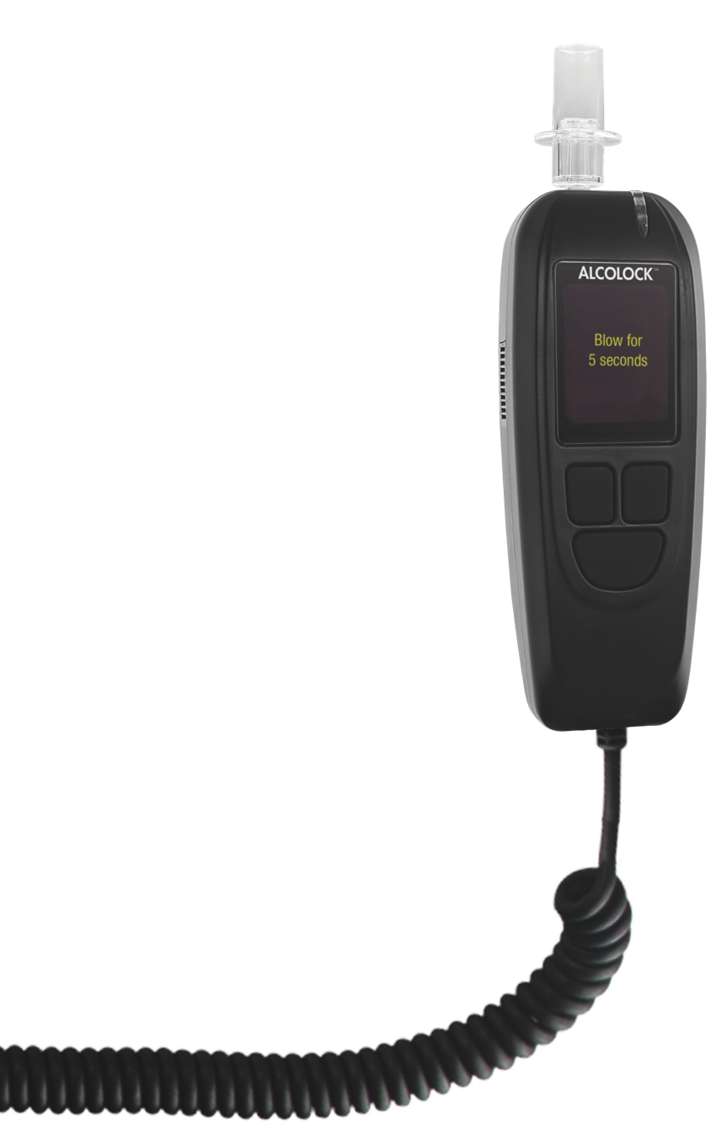
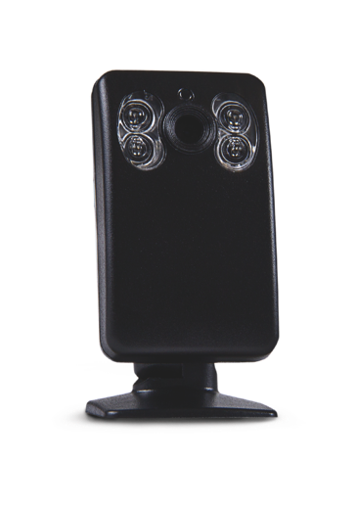
Commercial Alcohol Interlock
Optional accessories combine with L series to enhance safety
FOCUS camera
Takes a picture of the driver with each critical event
Image is sent with the test results to confirm driver identity
L Connect
Handset-only solution
Integrates directly into telematics systems and taxi meters
10

Slide 11
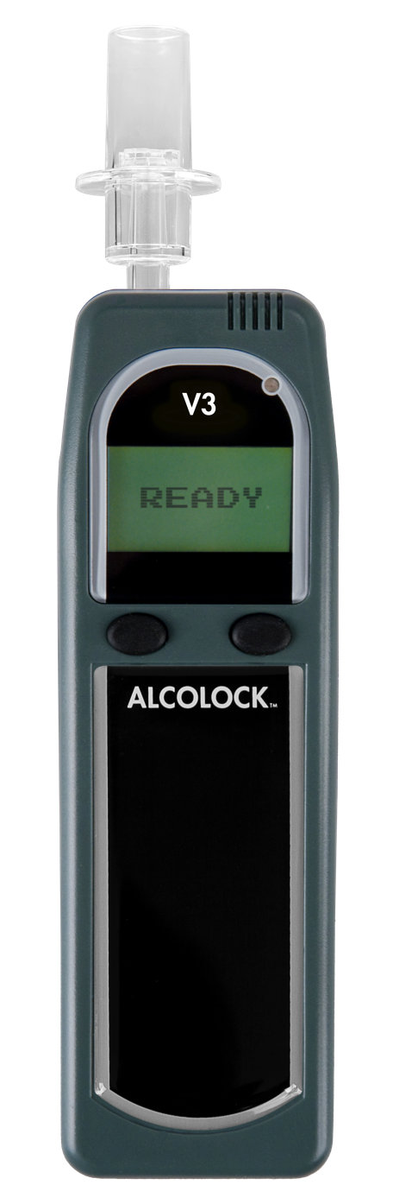
Commercial Alcohol Interlock
Designed for commercial fleet safety management programs
Prevents vehicle from starting unless the driver provides a breath sample below the limit
Rugged construction and reliable operation
Monitor operational vehicles remotely through a secure network application and telematic integration
11
Notes:
ALCOLOCK V3 alcohol interlock is designed for commercial (fleet) safety management programs. It prevents a vehicle from being started unless the driver provides an accepted breath sample with an alcohol concentration below the pre-set limit.
Rugged and reliable, ALCOLOCK V3 enables fleet managers to monitor operational vehicles remotely through a secure network application and telematic integration.

Slide 12

Law Enforcement

Slide 13
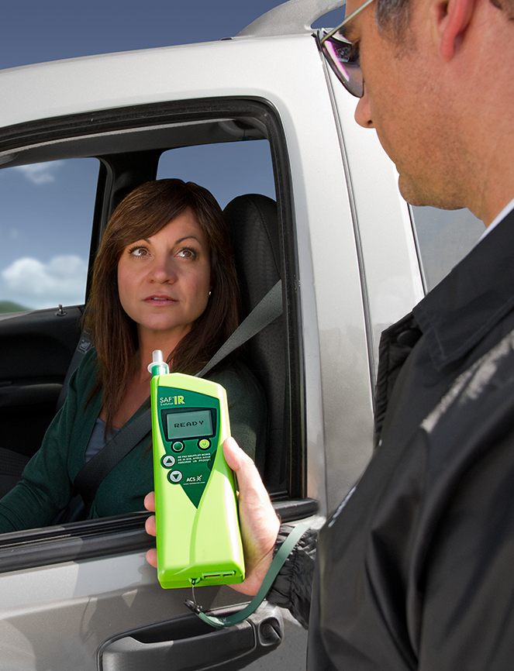

Evidential Breathalyzer

Slide 14

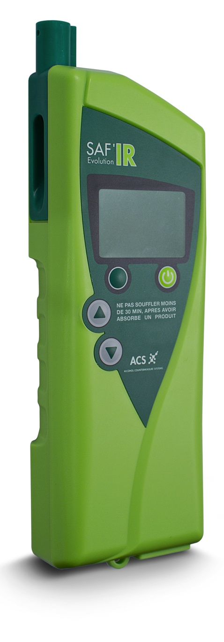
Evidential Breathalyzer
Industry-leading portable evidential breath alcohol tester
Infrared (IR) technology ensures highest available accuracy
Detects presence and concentration of alcohol in breath
Real-time analysis and mobile accuracy
Evidence can be stored, printed, or downloaded
  GPS coordinate record storage
  Bluetooth printing
  Download via direct USB connection
  User-friendly graphic display
  Robust construction
14
Notes:
SAF’IR is the industry leading portable evidential breath alcohol tester (EBT). Using infrared (IR) technology to ensure the highest available accuracy, the SAF’IR EBT detects the presence and concentration of alcohol in breath to meet legislative requirements.
With real-time analysis and mobile accuracy, evidence can be stored, printed in the field or downloaded via direct USB connection. GPS coordinate record storage, Bluetooth printing functionality, user-friendly graphic display, highly accurate sensor technology and robust construction are designed for superior use.

Slide 15


Professional Breathalyzers

Slide 16

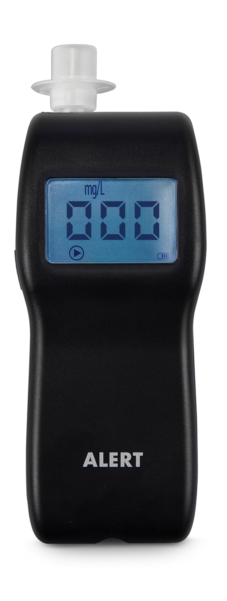
Professional Breathalyzer
Portable breath alcohol tester used in commercial and law enforcement operations
High-performance electrochemical sensor, the standard used by law enforcement
Quick response and rapid recycle between tests
One button operation
Icon display guides user through testing sequence
16
Notes:
ALERT is a portable breath alcohol tester (PBT) used in commercial and law enforcement operations.
The ALERT J4X uses a high performance electrochemical sensor – the standard for portable evidential breath testers used by law enforcement.
Providing quick response and rapid recycle between tests, the ALERT J4X uses one button operation and an iconic display to guide the user through the testing sequence.

Slide 17

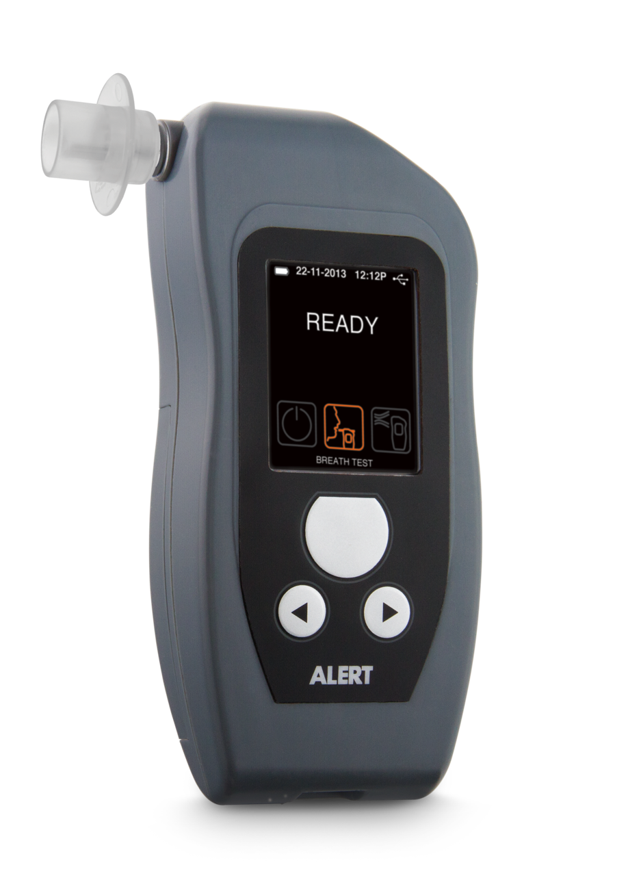
Professional Breathalyzer
Portable breath alcohol tester used in commercial and law enforcement operations
High-performance electrochemical sensor, the standard used by law enforcement
Active and passive breath sampling functionality
Increased storage capacity
Bluetooth printing capability
17
Notes:
ALERT is a portable breath alcohol tester (PBT) used in commercial and law enforcement operations.
The ALERT J5 uses a high performance electrochemical sensor – the standard for portable evidential breath testers used by law enforcement.
Providing both active and passive breath sampling functionality, increased storage capacity and Bluetooth printing capability, the ALERT J5 delivers enhanced professional accuracy in a compact single-unit design.

Slide 18
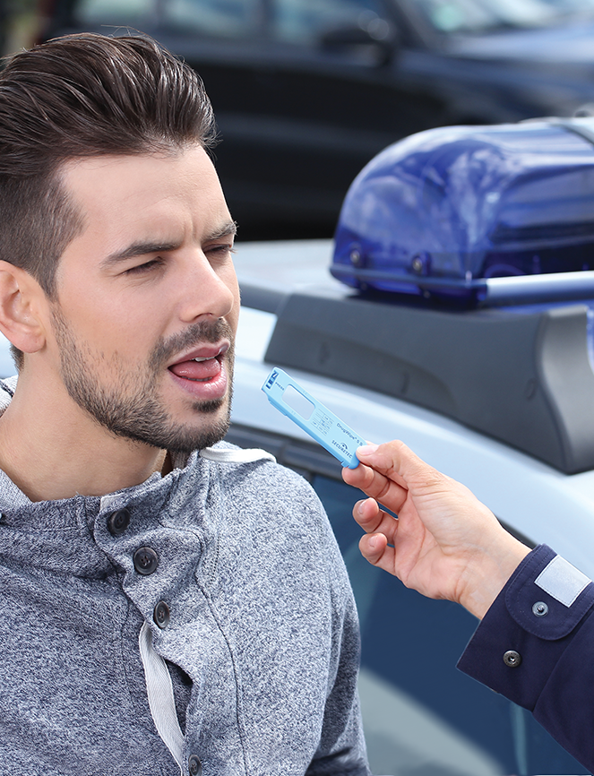

Drug Screening Solutions

Slide 19

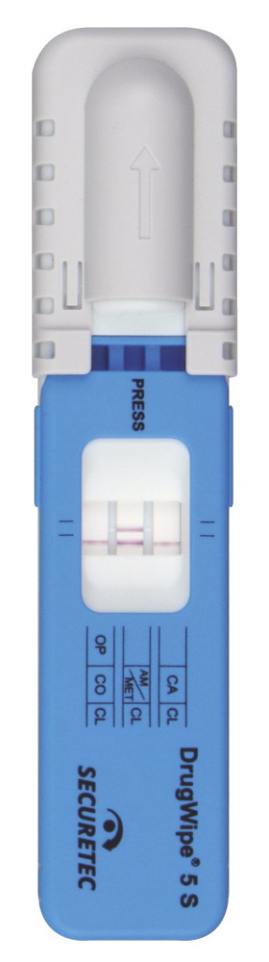
S
Drug Screening Solution
Hygienic one-time use oral fluid drug test
Reliability greater than 95%
Requires only 10 µL test sample
Accurate test results in 3-8 mins
Test for a range of drugs:
Amphetamines
Benzodiazepines
Cannabis
Cocaine
Methamphetamines
Opiates
Test of choice for police officers, customs officials, border control, rehabilitation clinics, correctional facilities, and EMS personnel
19
Notes:
DrugWipe is the leading choice for police officers, customs officials, border control, rehabilitation clinics, correctional facilities and emergency medical service personnel for oral fluid (saliva) based testing for drug abuse.
Designed to test for a range of drugs:
Amphetamines
Benzodiazepines
Cannabis
Cocaine
Ketamine
Methamphetamines
Opiates
DrugWipe reliable and hygienic, requiring only 10 µL test sample by swabbing the tongue. It delivers accurate test results in minutes.

Slide 20
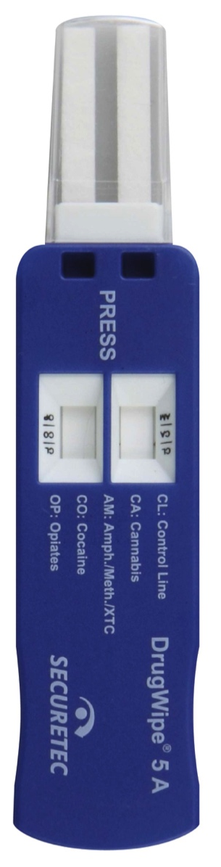
A
Drug Screening Solution
Hygienic one-time use drug test (saliva, sweat, surfaces)
Reliability greater than 95%
Accurate test results in 3-8 mins
Test for a range of drugs:
Amphetamines
Benzodiazepines
Cannabis
Cocaine
Methamphetamines
Opiates
Test of choice for police officers, customs officials, border control, rehabilitation clinics, correctional facilities, and EMS personnel
20
Notes:
DrugWipe is the leading choice for police officers, customs officials, border control, rehabilitation clinics, correctional facilities and emergency medical service personnel for oral fluid (saliva) based testing for drug abuse.
Designed to test for a range of drugs:
Amphetamines
Benzodiazepines
Cannabis
Cocaine
Ketamine
Methamphetamines
Opiates
DrugWipe reliable and hygienic, requiring only 10 µL test sample by swabbing the tongue. It delivers accurate test results in minutes.

Slide 21
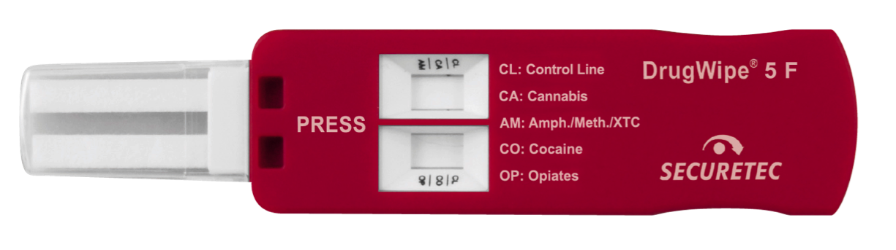
F
Drug Screening Solution
Hygienic one-time use surface drug test
Reliability greater than 95%
Accurate test results in 3-8 mins
Test for a range of drugs:
Amphetamines
Benzodiazepines
Cannabis
Cocaine
Methamphetamines
Opiates
Test of choice for police officers, customs officials, border control, rehabilitation clinics, correctional facilities, and EMS personnel
21
Notes:
DrugWipe is the leading choice for police officers, customs officials, border control, rehabilitation clinics, correctional facilities and emergency medical service personnel for oral fluid (saliva) based testing for drug abuse.
Designed to test for a range of drugs:
Amphetamines
Benzodiazepines
Cannabis
Cocaine
Ketamine
Methamphetamines
Opiates
DrugWipe reliable and hygienic, requiring only 10 µL test sample by swabbing the tongue. It delivers accurate test results in minutes.

Slide 22
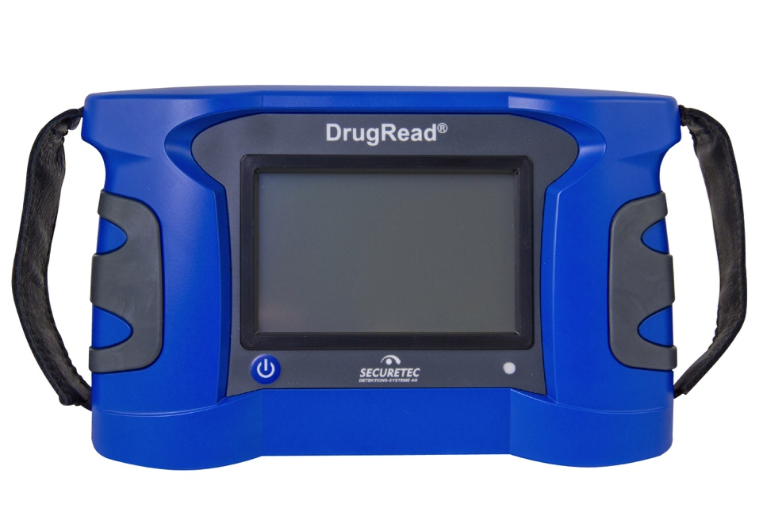
DrugRead
®
Drug Screening Solution
User-friendly interpretation of DrugWipe® saliva tests
Mobile opto-electronical photometer for analysis and documentation
Objective, documented and reliable – shows a clear YES or NO result
Easy to use touch screen with high brightness
Compatible with Bluetooth printer for printed results on the spot
Ideal for use at roadside control, border checkpoints, police departments, rehabilitation clinics, and correctional facilities
22
Notes:
DrugWipe is the leading choice for police officers, customs officials, border control, rehabilitation clinics, correctional facilities and emergency medical service personnel for oral fluid (saliva) based testing for drug abuse.
Designed to test for a range of drugs:
Amphetamines
Benzodiazepines
Cannabis
Cocaine
Ketamine
Methamphetamines
Opiates
DrugWipe reliable and hygienic, requiring only 10 µL test sample by swabbing the tongue. It delivers accurate test results in minutes.

Slide 23

Criminal Justice

Slide 24
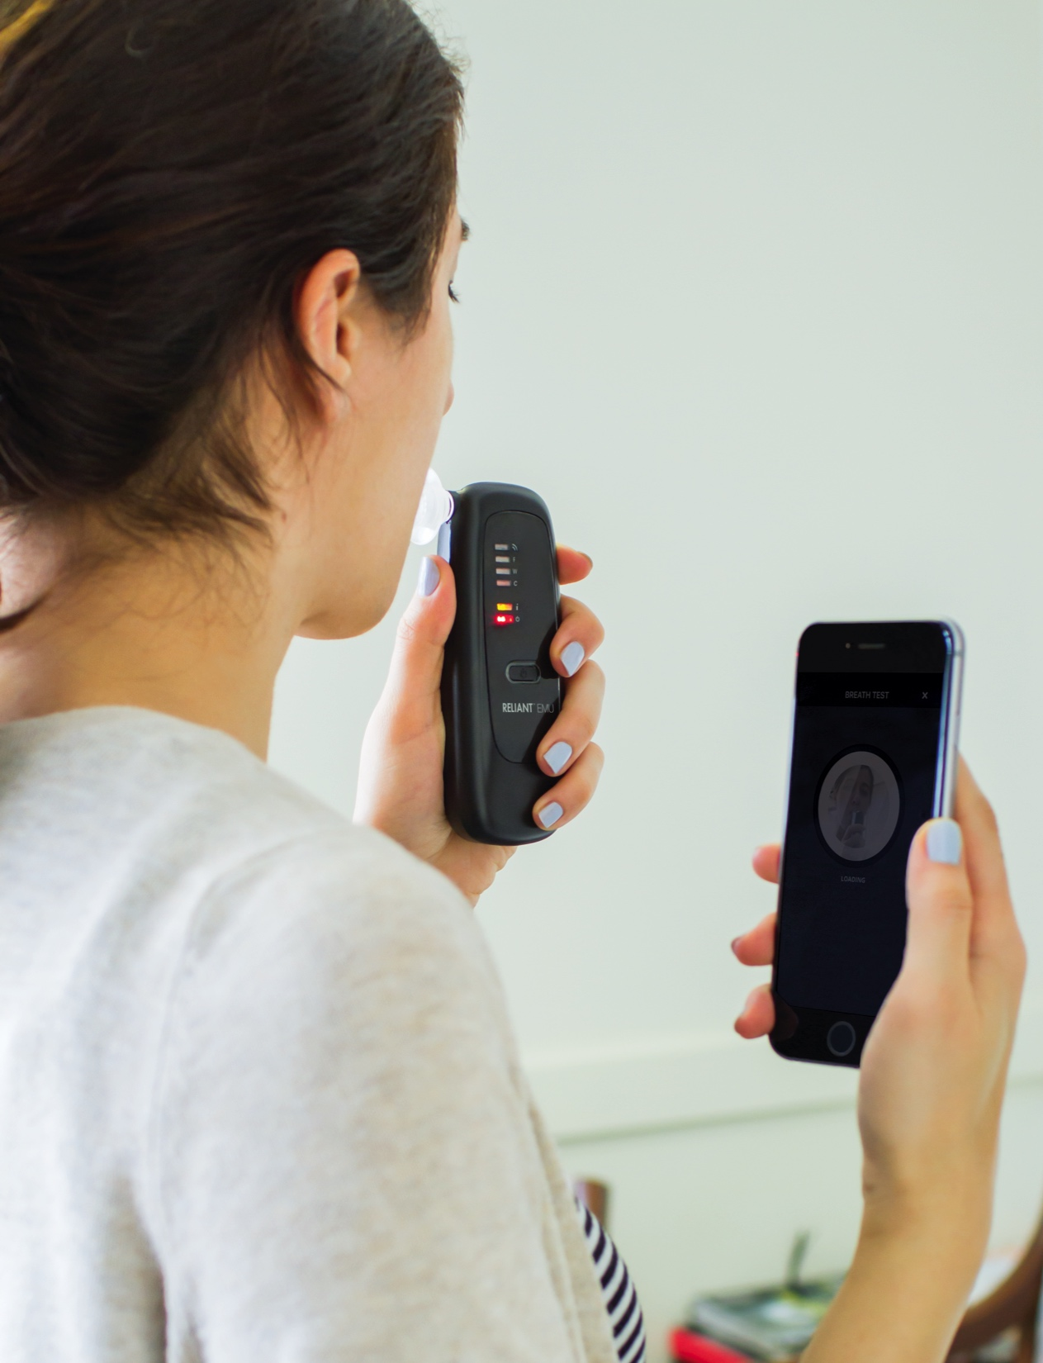

Remote Alcohol Monitoring

Slide 25

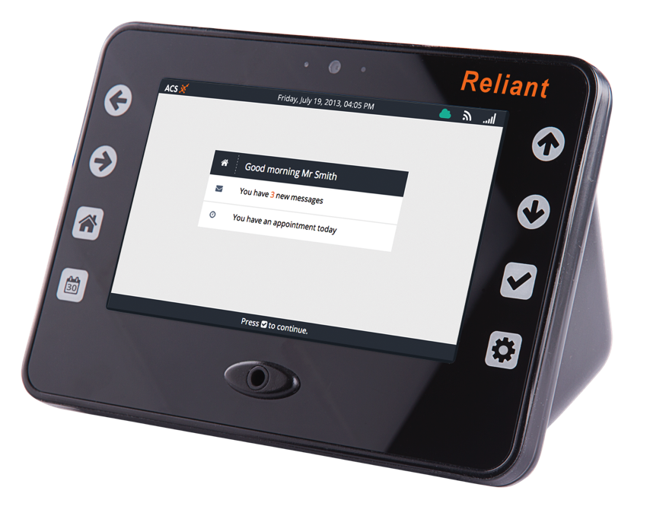
Remote Alcohol Monitoring
Confirm adherence to alcohol-free or zero tolerance policies in community supervision, home confinement or 24/7 applications
Used in electronic monitoring programs for subjects on pretrial, parole, probation or court order
Biometric ID confirmation (facial, ECG, fingerprint)
Location-based breath alcohol measurements
GPS coordinates with data and time stamp tracks offender progress
Real-time reporting through GSM, Wi-Fi or LAN
25
Notes:
RELIANT RMU provides a means of confirming adherence to alcohol-free or zero tolerance policies for persons on probation or supervision. Its portability enables offender monitoring at home or in the workplace.
RELIANT RMU enables monitoring personnel to remotely determine compliance of offenders with biometric ID, location based breath alcohol measurements and interactive reporting capabilities.
RELIANT RMU uses GPS coordinates with data and time stamp to track offender progress with real time reporting through GSM, Wi-Fi or LAN.

Slide 26

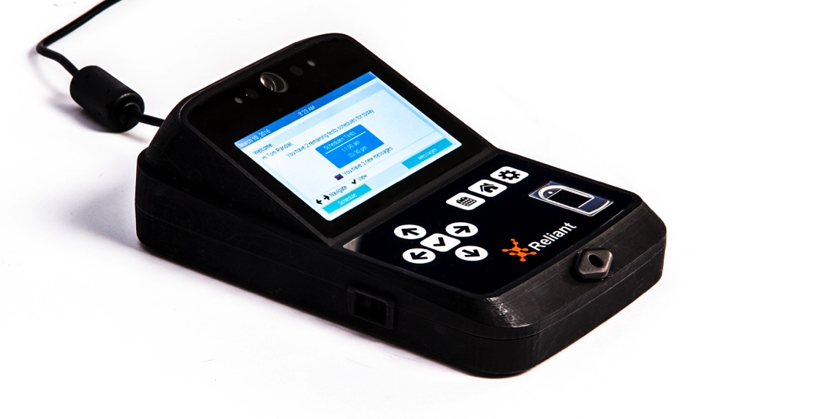
Remote Alcohol Monitoring
Confirms adherence to alcohol-free or zero tolerance policies for persons on probation or supervision
Enables monitoring personnel to remotely determine compliance
Biometric ID confirmation (facial, ECG, fingerprint)
Location-based breath alcohol measurements
GPS coordinates with data and time stamp to track offender progress
Real-time reporting through GSM, Wi-Fi or LAN
26
Notes:
The RELIANT VMU confirms the adherence to an alcohol-free lifestyle for those who require community supervision, home confinement or 24/7 remote monitoring.
The RELIANT VMU enables monitoring personnel to remotely determine compliance of the offender with location based breath alcohol measurements, biometric confirmation, facial images and interactive reporting capabilities.
The RELIANT VMU uses a multi-faceted biometric approach to confirm identity of the offender and to thwart attempts at circumvention of the breath sample. It uses GPS coordinates with time and date monitoring and reporting through GSM, Wi‑Fi or LAN.

Slide 27

Remote Alcohol Monitoring
Portable breath alcohol tester connected to a smartphone
Communicates with a central database for electronic monitoring and remote supervision
Cellular and Bluetooth connectivity
Image capture and geo-localization functions
Subject tracking, biometric ID and alcohol monitoring
Online scheduling, messaging and remedial intervention
27
Notes:
RELIANT EMU is a portable breath alcohol tester connected to a smartphone through a proprietary application for communication with a central database for electronic monitoring of subjects.
The device uses the smartphone cellular and Bluetooth connectivity together with its image capture and geo-localization functions to provide remote supervision that provides subject tracking, biometric ID and alcohol monitoring with online scheduling, messaging and remedial intervention.

Slide 28

Health & Safety

Slide 29



Passive Breath Alcohol Tester

Slide 30

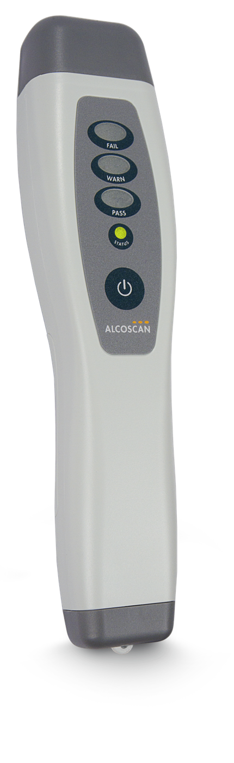
Passive Breath Alcohol Tester
Easy-to-use passive breath alcohol tester
Detects the presence of alcohol within the ambient environment
Highly sensitive electrochemical sensor processes a sample from the air
Provides results in seconds
No mouthpieces or special attachments required
30
Notes:
ALCOSCAN is an easy-to-use,
passive breath alcohol tester that detects the presence of alcohol within the ambient environment.
The highly sensitive electrochemical sensor quickly processes a sample from the air and provides the results in seconds with no mouthpieces or special attachments required.

Slide 31


Alcohol Screening System

Slide 32

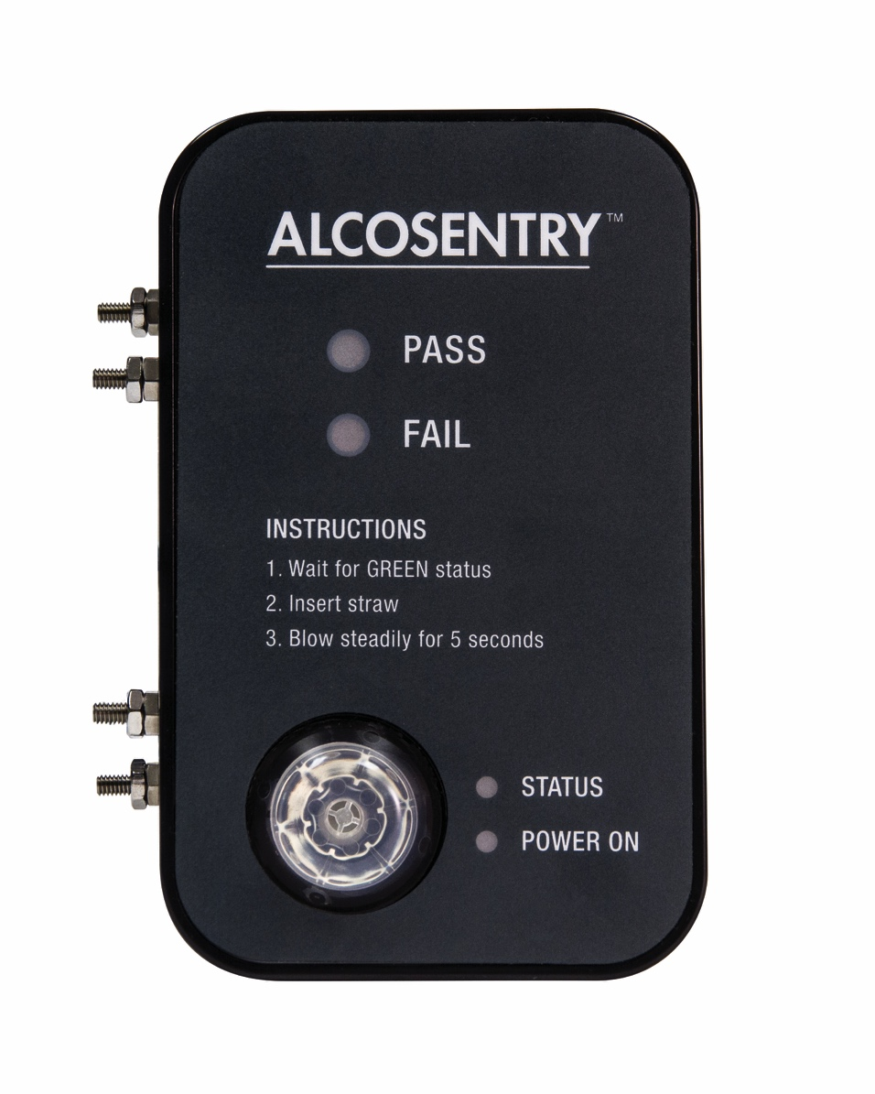
Alcohol Screening System
Access control system with breath alcohol monitoring
Controls access to secure environments
Processes as an autonomous unit
or through LAN connection
Designed for safety sensitive industries with high volume screening requirements
Ensures safety of personnel
Fully automated and non-invasive
32
Notes:
ALCOSENTRY access control system with breath alcohol monitoring controls access to secure environments and processes as an autonomous unit or through connection with a LAN.
Designed for safety sensitive industries with high volume screening requirements, ALCOSENTRY ensures safety of personnel.
Fully automated and non-invasive, ALCOSENTRY is designed for accuracy, security and ease of use.

Slide 33


Breath Alcohol Tester

Slide 34

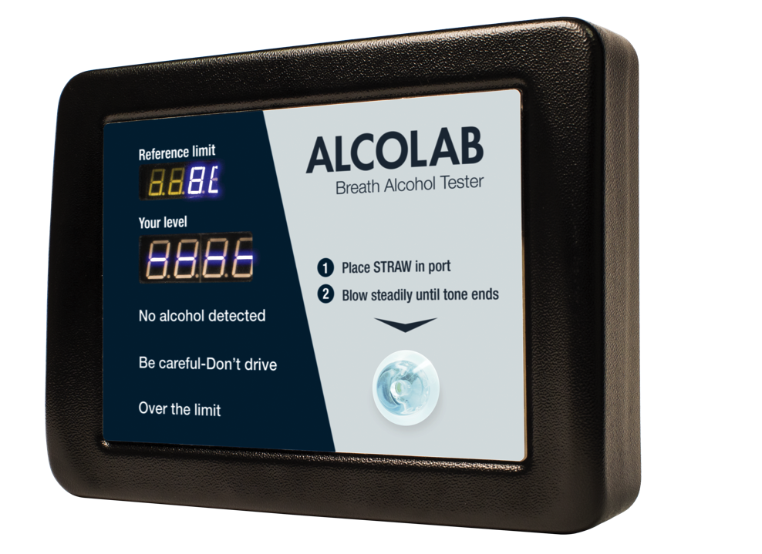
Breath Alcohol Tester
Breath alcohol tester designed for public use and safety sensitive industries
Professional-grade accuracy and user friendly operation
Users can self-administer breath alcohol tests
Fully automated and easy to use
LED display indicates BrAC level and reference limit
34
Notes:
The ALCOLAB is a breath alcohol tester designed for public use and safety sensitive industries. It provides professional-grade accuracy and user friendly operation
to ensure users can conveniently self administer their own breath alcohol tests with confidence. Fully automated and easy to use, it is engineered for accuracy, reliability
and security.
The ALCOLAB is fast, reliable and fully automated. Simply insert a straw into the ALCOLAB port and blow moderately and continuously for five seconds. The user friendly, LED display indicates the user’s
BrAC level and the reference limit.

Slide 35

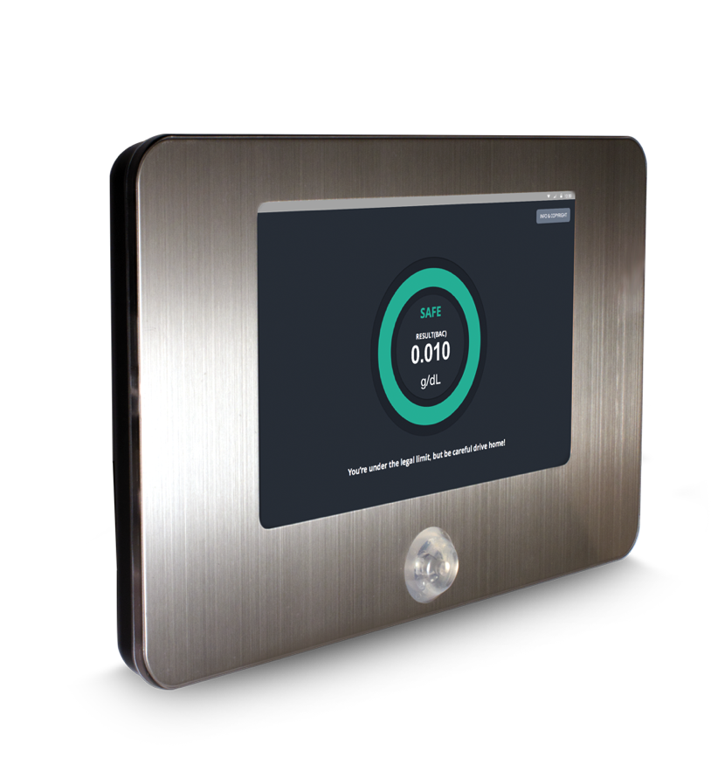
Breath Alcohol Tester
Alcohol monitoring in the workplace or in public venues
Convenient, safe and accurate
Interactive display in a compact, lightweight, durable design
Connects with Bluetooth or LAN
Multifunctional applications in bars, clubs or restaurants, corporate events and safety control
35
Notes:
ALCOLAB test point features industry leading technology for alcohol monitoring in the workplace or in public venues. It is built for convenience, safety and accuracy with an interactive display within a compact, light weight, durable design.
ALCOLAB test point connects with Bluetooth or LAN to provide multifunctional applications in bars, clubs or restaurants, corporate events and safety control.

Slide 36

Personal Safety

Slide 37


Personal Breathalyzers

Slide 38

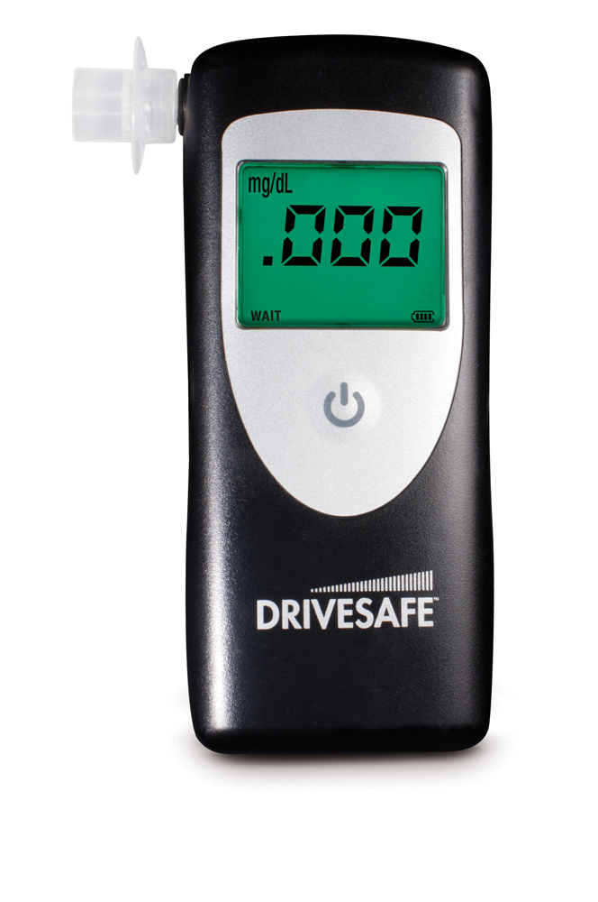
Personal Breathalyzer
High-performance electrochemical sensor
Icons on the LCD screen guide
user through test sequence
All functions are controlled using a single button
Simple, robust design for use in clinical or industrial settings
Results displayed on 3-digit LCD screen, with a graphical intensity meter and tri-colour backlight
38
Notes:
DRIVESAFE exec uses a high performance electrochemical sensor, the standard for professional breathalyzers, ensuring stability and accuracy.
Icons on the LCD screen guide the user confidently through the test sequence. All functions are controlled using a single button.
DRIVESAFE exec has a simple, robust design for effective use in clinical or industrial settings.
It displays results using a large, 3-digit LCD screen, along with a graphical intensity meter and tri-colour backlight for clarity.

Slide 39


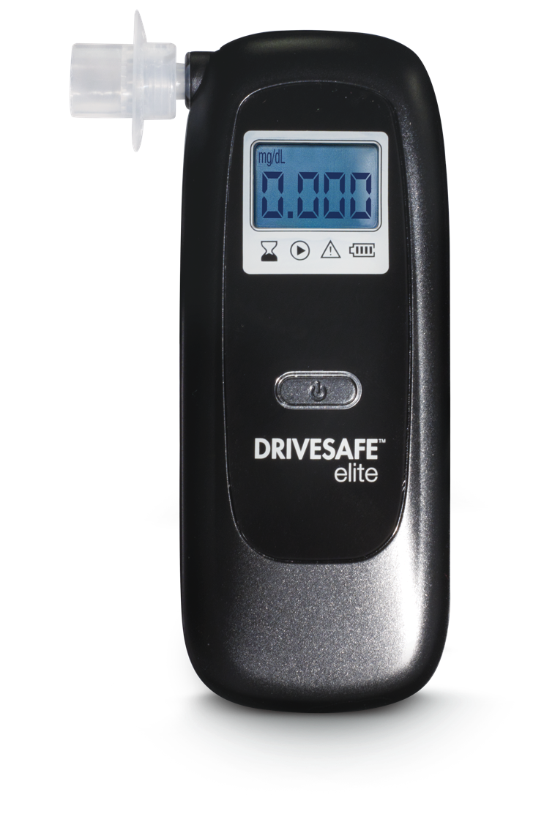
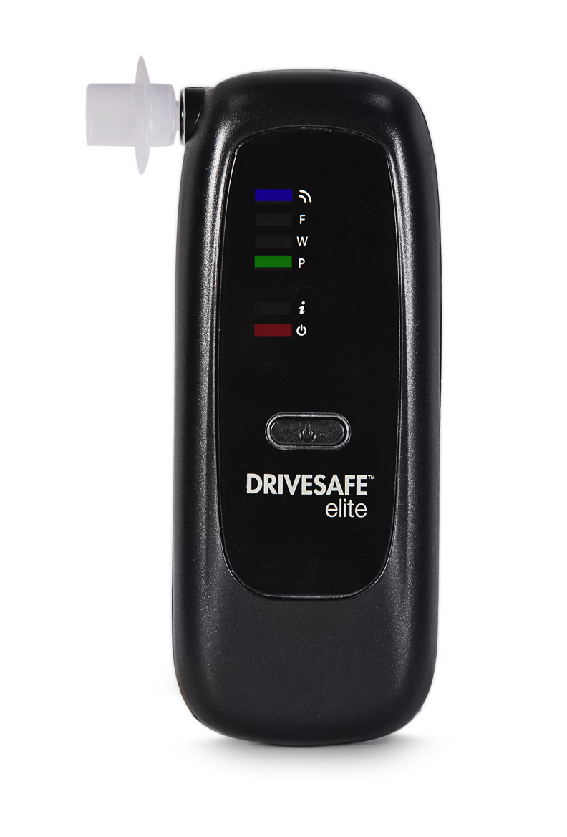
Personal Breathalyzer
High-performance electrochemical sensor
Guides the user through the test sequence
Results are displayed quickly and clearly
4-digit LCD screen guide (standard version)
3 LED Pass/Warn/Fail indicator (Bluetooth version)
Compact design for easy, discreet use
39
Notes:
DRIVESAFE elite uses a high performance electrochemical sensor, the standard for professional breathalyzers, ensuring stability and accuracy.
Results are displayed on a 4-digit LCD screen guide or 3 LED (Pass,Warn,Fail) on the BT (Bluetooth) version. Both guide the user confidently through the test sequence.
DRIVESAFE elite has a compact design for easy, discreet use, with results being displayed quickly and clearly.

Slide 40

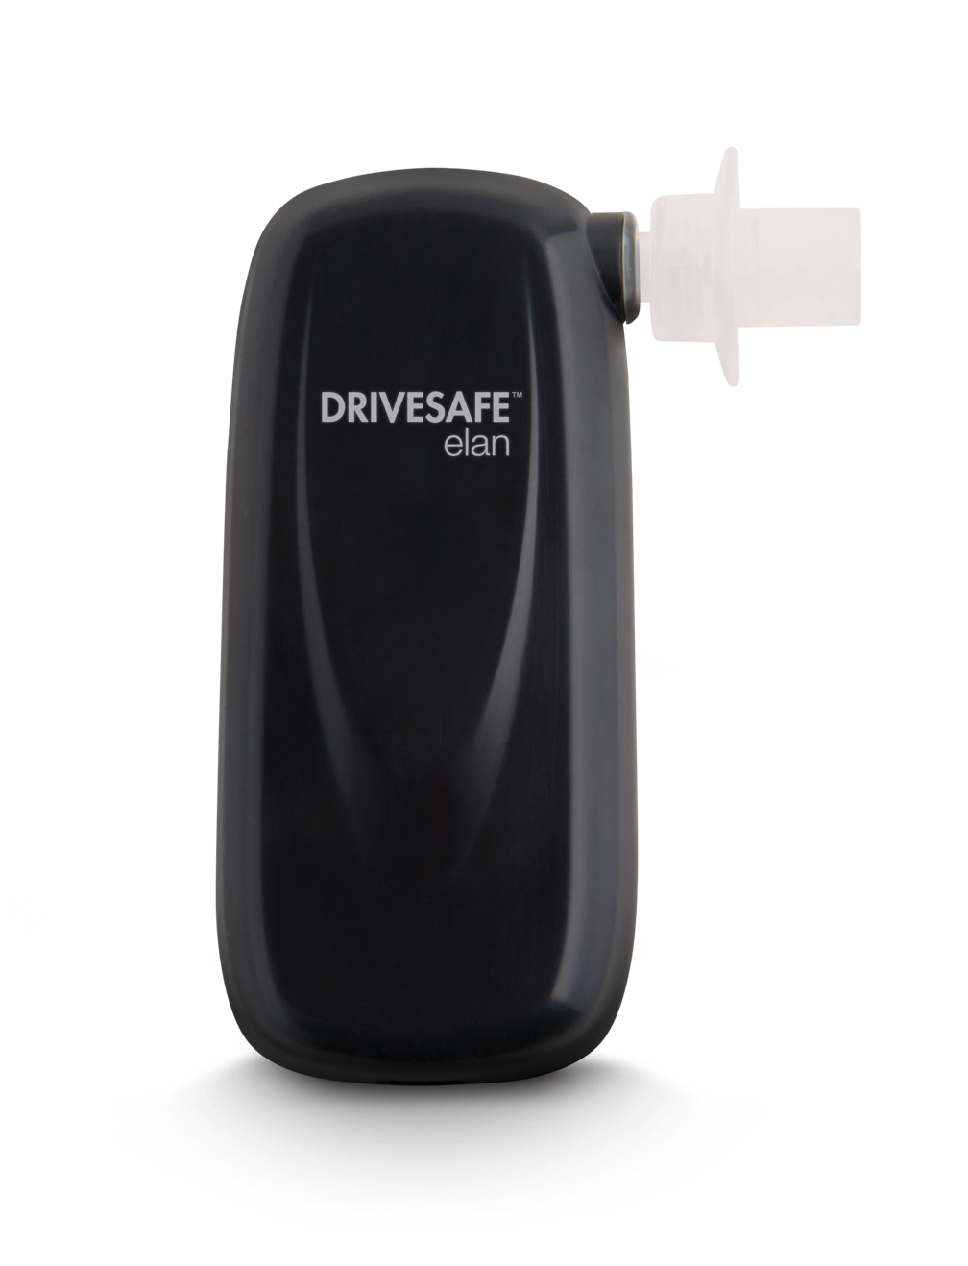
Personal Breathalyzer
High-performance electrochemical sensor
Pairs with smartphone via USB cable
Prompts on the screen guide user through the breath alcohol test
Test results are displayed directly on your phone
Record height, weight and gender for personalized estimates of Breath Alcohol Concentration (BrAC)
40
Notes:
DRIVESAFE élan uses a high performance electrochemical sensor, the standard for professional breathalyzers, ensuring stability and accuracy.
The DRIVESAFE élan smartphone App provides an effortless interface.
The App records your height, weight and gender for personalized functions when estimating your Breath Alcohol Concentration (BrAC).

Slide 41

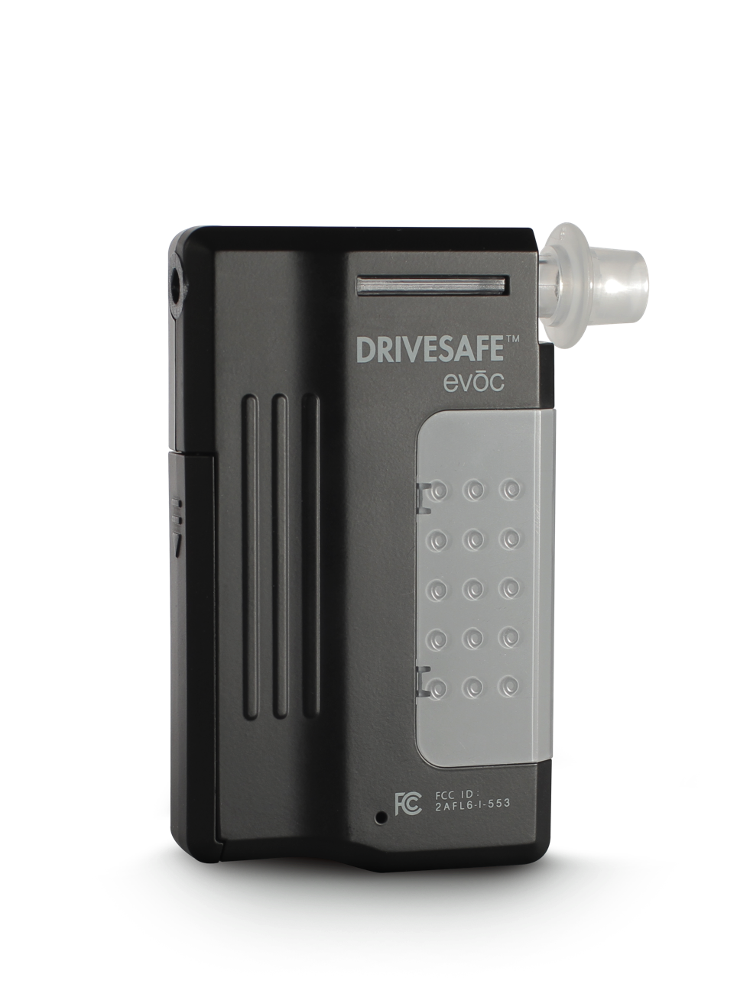
Personal Breathalyzer
High-performance electrochemical sensor
Pairs with smartphone via Bluetooth wireless connection
Prompts on the screen guide user through the breath alcohol test
Smartphone app displays and stores test results and gives an estimated time to recover sobriety
Share test results via Twitter, Facebook, or text message
41
Notes:
DRIVESAFE evōc uses a high performance electrochemical sensor, the standard for professional breathalyzers, ensuring stability and accuracy.
The DRIVESAFE evōc smartphone App is simple and intuitive. The App displays and stores test results and gives an estimated time to recover sobriety.

Slide 42
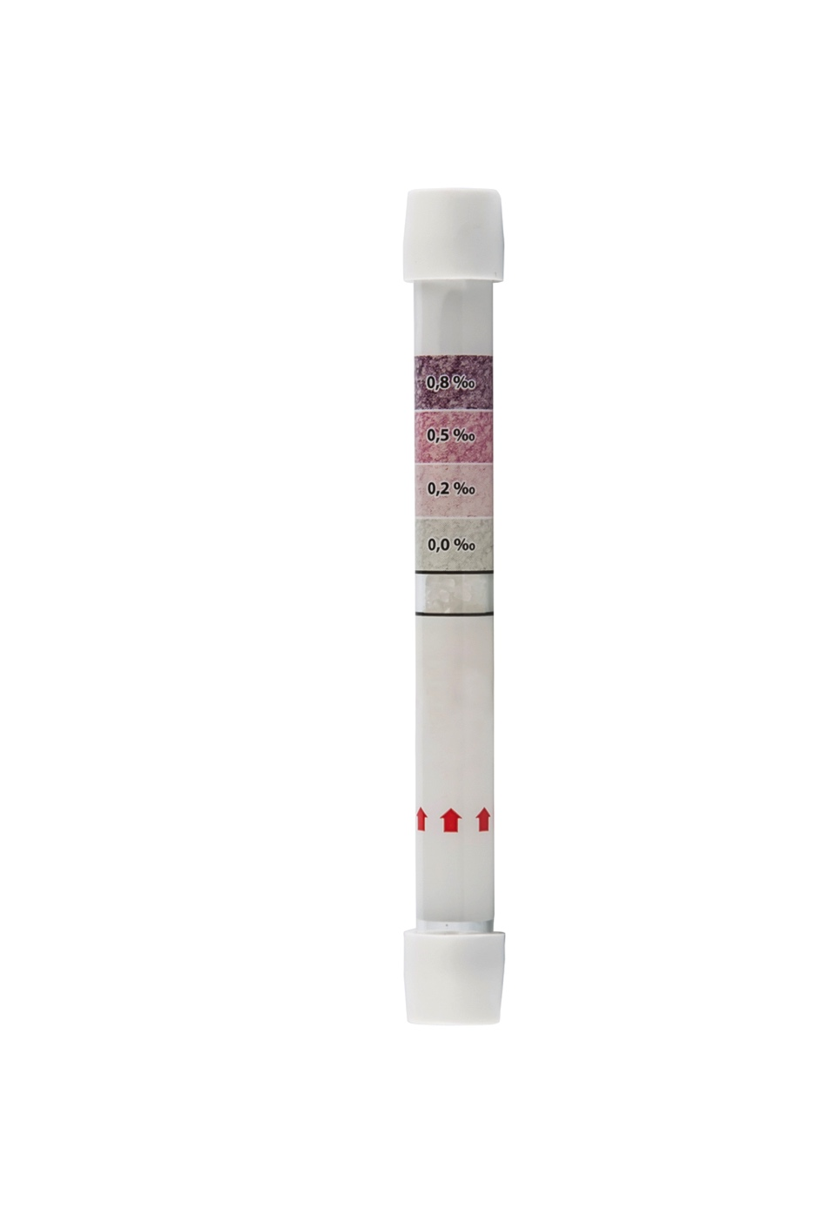
Personal Breathalyzer
Single use breath alcohol tester
Discreet, convenient, and
non-invasive
Provides accurate, easy to read reliable results
Crystals change colour upon detection of alcohol when the user blows through the tube
The more intense the colour, the higher the alcohol concentration
Four level indicator to easily see BrAC results in 2 to 4 minutes
42
Notes:
DRIVESAFE™ express is a discrete, convenient, noninvasive, single use breath alcohol tester providing accurate, reliable results with easy to read color changing crystals. It’s perfect for personal or professional use.
The DRIVESAFE express contains crystals within a single tube. When the user blows through the tube, the crystals change colour upon detection of alcohol; the more intense the colour, the higher the alcohol concentration. The DRIVESAFE express uses a four level indicator to easily see your BrAC within 2 to 4 minutes.

Slide 43

Metrology

Slide 44
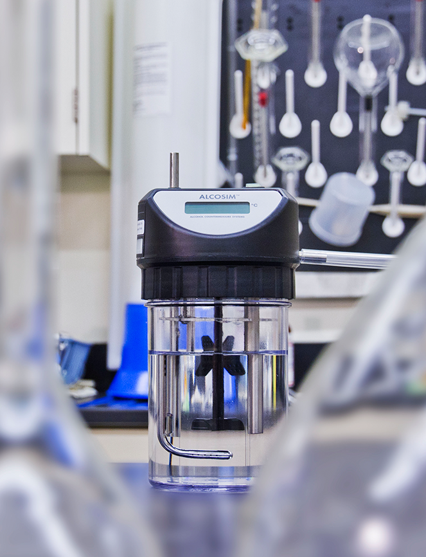

Breath Alcohol Simulator

Slide 45

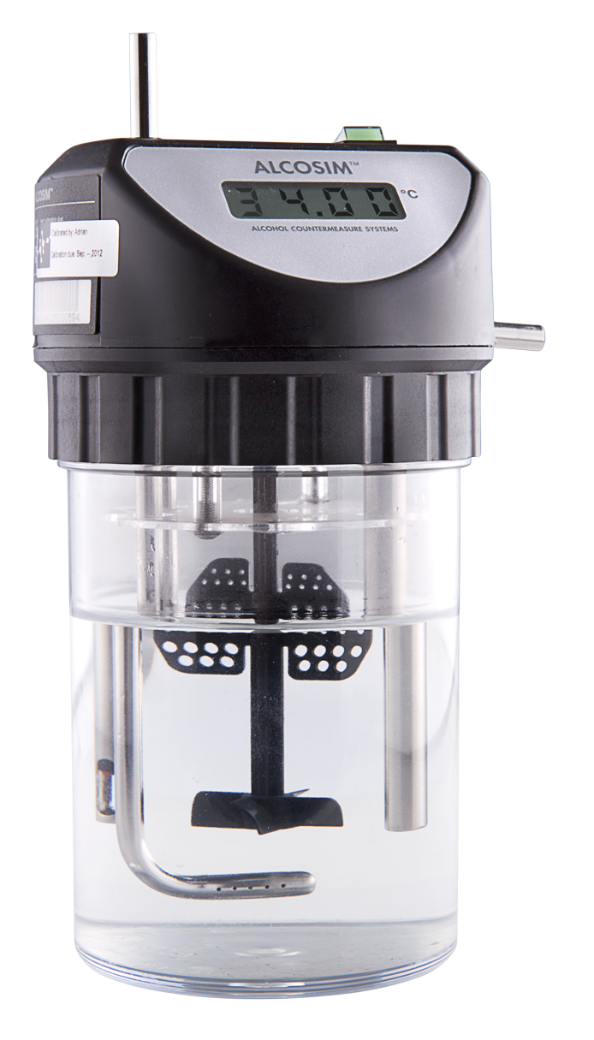
Breath Alcohol Simulator
Breath alcohol simulator for easy and accurate calibration or verification of breath alcohol testing instruments
Carefully maintained alcohol reference solution temperature to 34 ± 0.02 ℃
Produces an air-alcohol sample of precise concentration
Fully compatible for use by ISO 17025 qualified test laboratories
45
Notes:
ALCOSIM breath alcohol simulator is an easy and accurate way to calibrate or verify breath alcohol testing instruments.
Carefully maintaining the temperature of alcohol reference solution to within 34 ± 0.02 ℃, it produces an air-alcohol sample of precise concentration.
ALCOSIM is fully compatible for use by ISO 17025 qualified test laboratories for testing the accuracy of breath alcohol testing instruments.

Slide 46
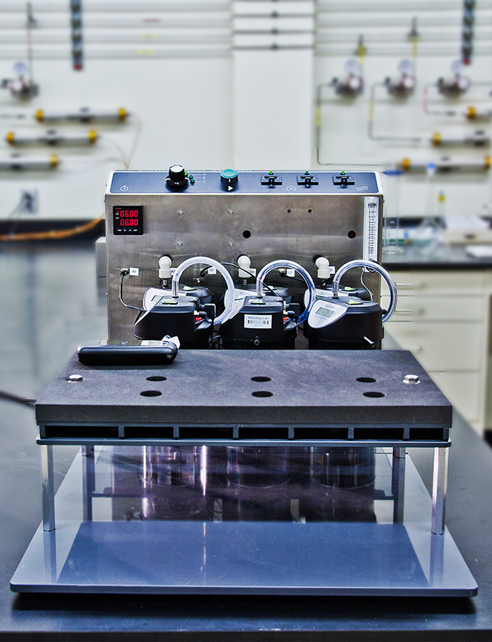

Calibration Solution

Slide 47

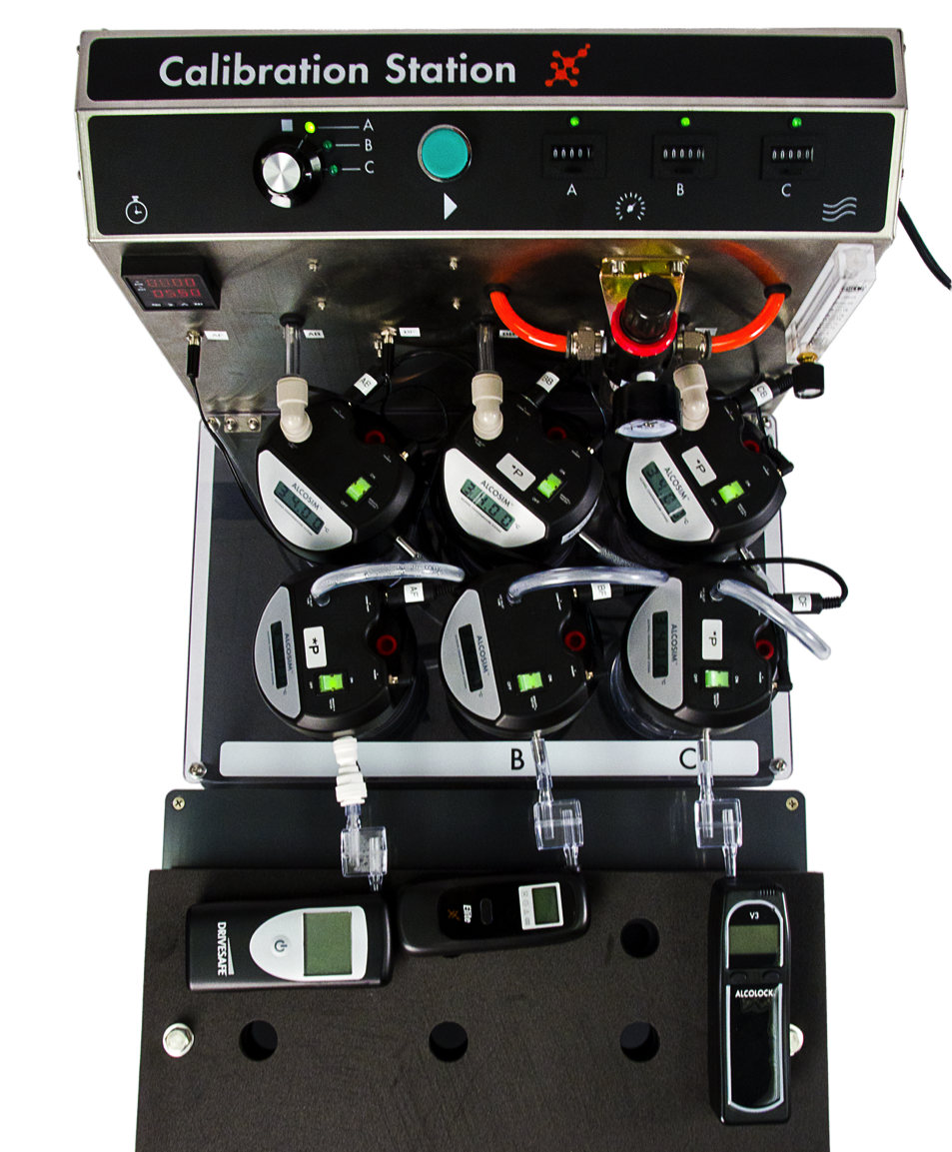
Calibration Solution
Multi-tiered laboratory station for calibration of all handheld breath alcohol testers
Optimizes gas flow and alcohol reference solution use
Eliminates human error
Provides consistent simulated breath samples
Three tandems can be used with different concentrations of alcohol reference solution
Able to calibrate a breath tester to a wide range of thresholds
47
Notes:
ALCOSIM calibration bench is a multi-tiered laboratory station that optimizes gas flow, alcohol reference solution use, eliminates human error and provides consistent simulated breath samples for calibration of all handheld breath alcohol testers.
Three tandems of ALCOSIM breath alcohol simulators can be used with different concentrations of alcohol reference solution, calibrating a breath tester to a wide range of thresholds to accommodate varied operational requirements.

Slide 48
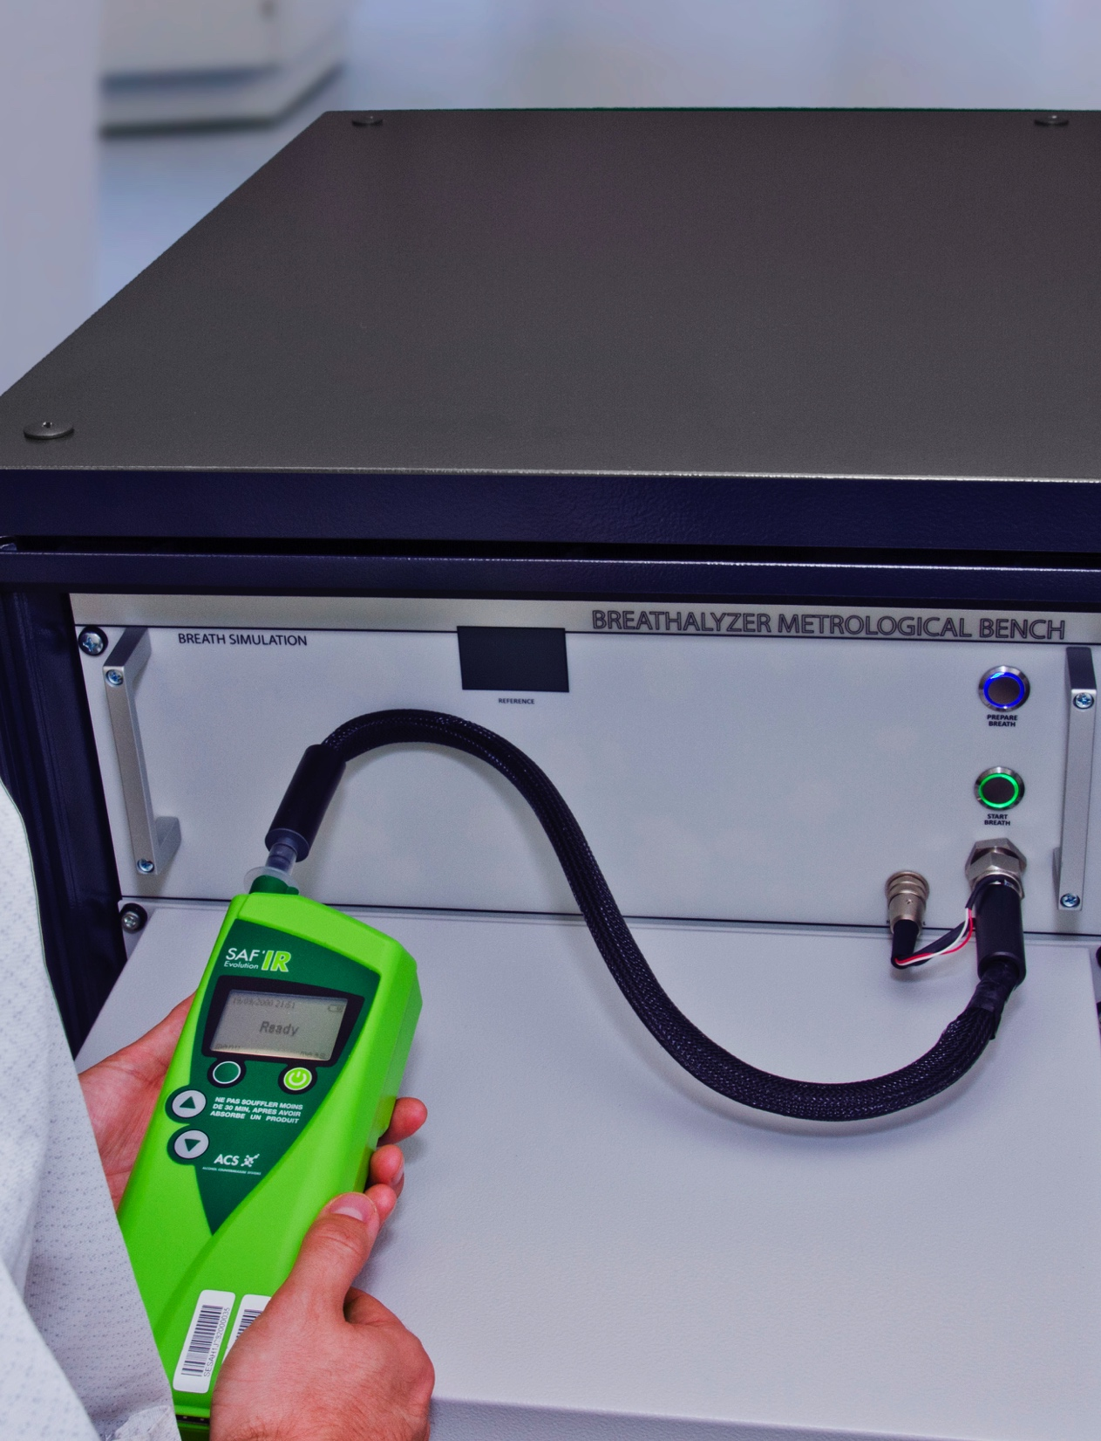
Calibration Solutions

Slide 49
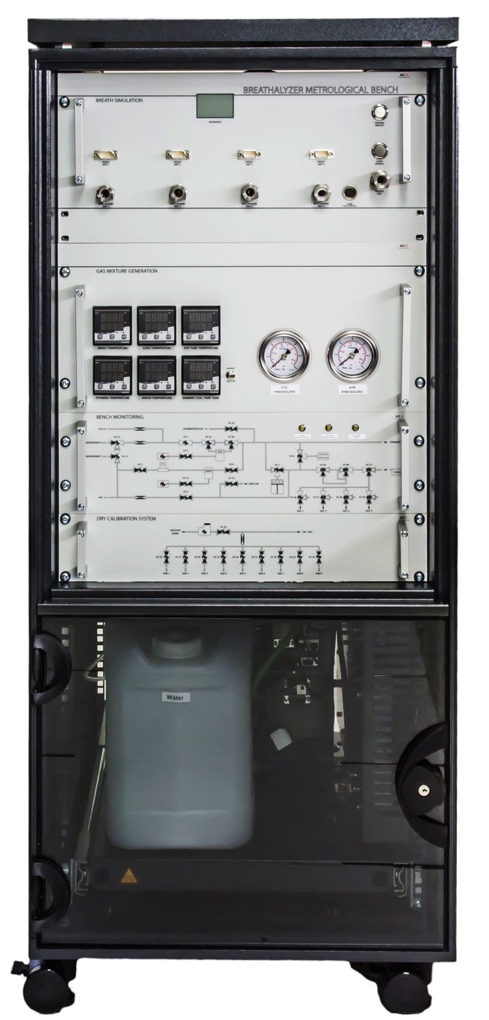
Calibration Solution
Designed for type testing of breath alcohol instruments against international standards
Provides the means for high volume verification testing of alcohol breath testers
Combined system optimizes mass flow control and proportional valve release
Provides high flexibility and multiple component mixture
Optimal pressure, flow, temperature and volume control
49
Notes:
The Metrological Test Bench is designed for type testing of breath alcohol instruments against international standards and also provides the means for high volume verification testing of EBTs, where efficiency and accuracy are critical customer requirements.
Using a combined system which optimizes mass flow control and proportional valve release, the Metrological Test Bench provides high flexibility, multiple component mixture and optimal pressure, flow, temperature and volume control.

Slide 50
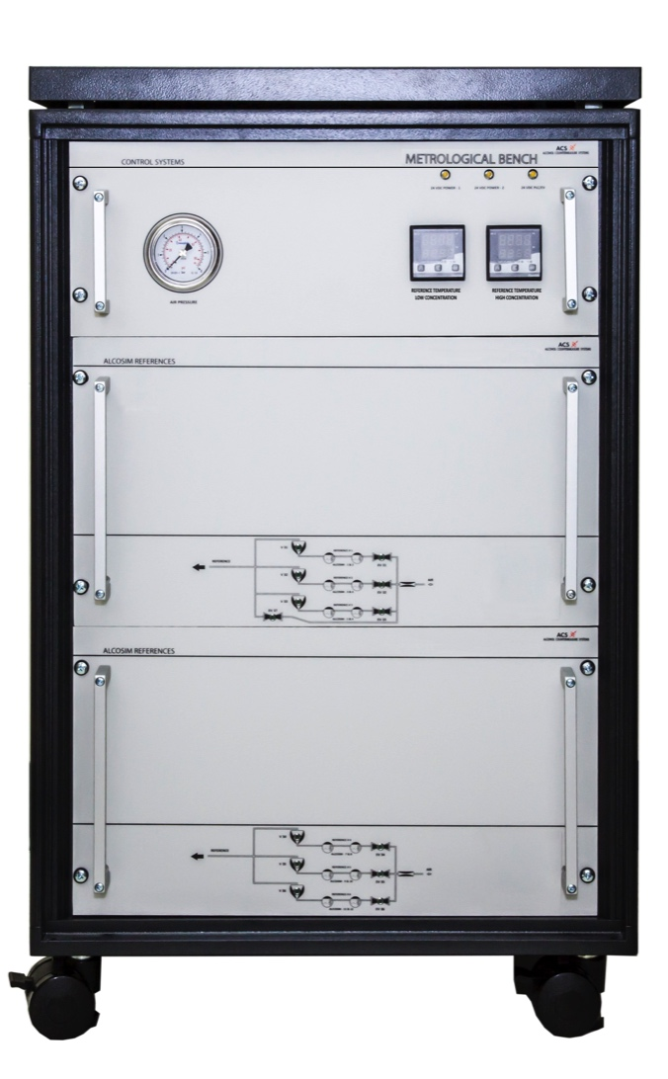
Calibration Solution
Standard calibration reference for the large Metrological Test Bench
Small calibration bench used in conjunction with the larger bench
Reduces downtime as a result of the need for external recalibration
50
Notes:
The Metrological Test Bench is designed for type testing of breath alcohol instruments against international standards and also provides the means for high volume verification testing of EBTs, where efficiency and accuracy are critical customer requirements.
Using a combined system which optimizes mass flow control and proportional valve release, the Metrological Test Bench provides high flexibility, multiple component mixture and optimal pressure, flow, temperature and volume control.

Slide 51
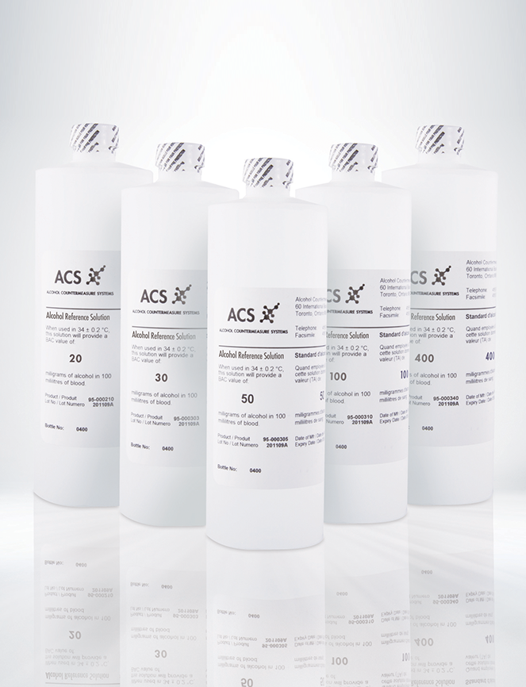

Alcohol Reference Solutions

Slide 52

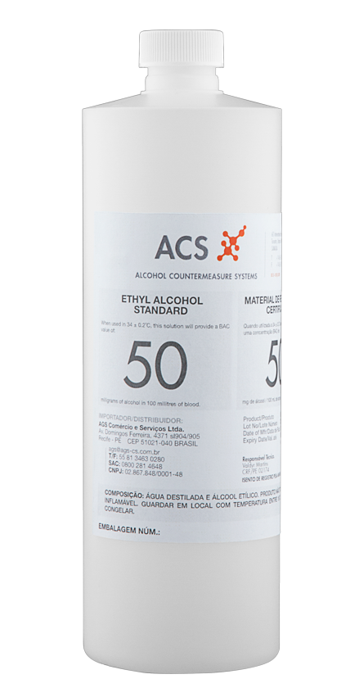
Alcohol Reference Solution
Premixed and ready for immediate use with a breath alcohol simulator
Eliminates the requirement of mixing in the field
Accuracy of the concentration is traceable to NIST reference standard
Verified 2 year shelf life
52
Notes:
ACS alcohol reference solution (ARS) is premixed, ready for immediate use with a breath alcohol simulator, eliminating the requirement of mixing in the field.
The accuracy of the alcohol reference solution concentration is traceable to the NIST (National Institute of Standards and Technology_) reference standard and has a verified two (2) year shelf life.

Slide 53
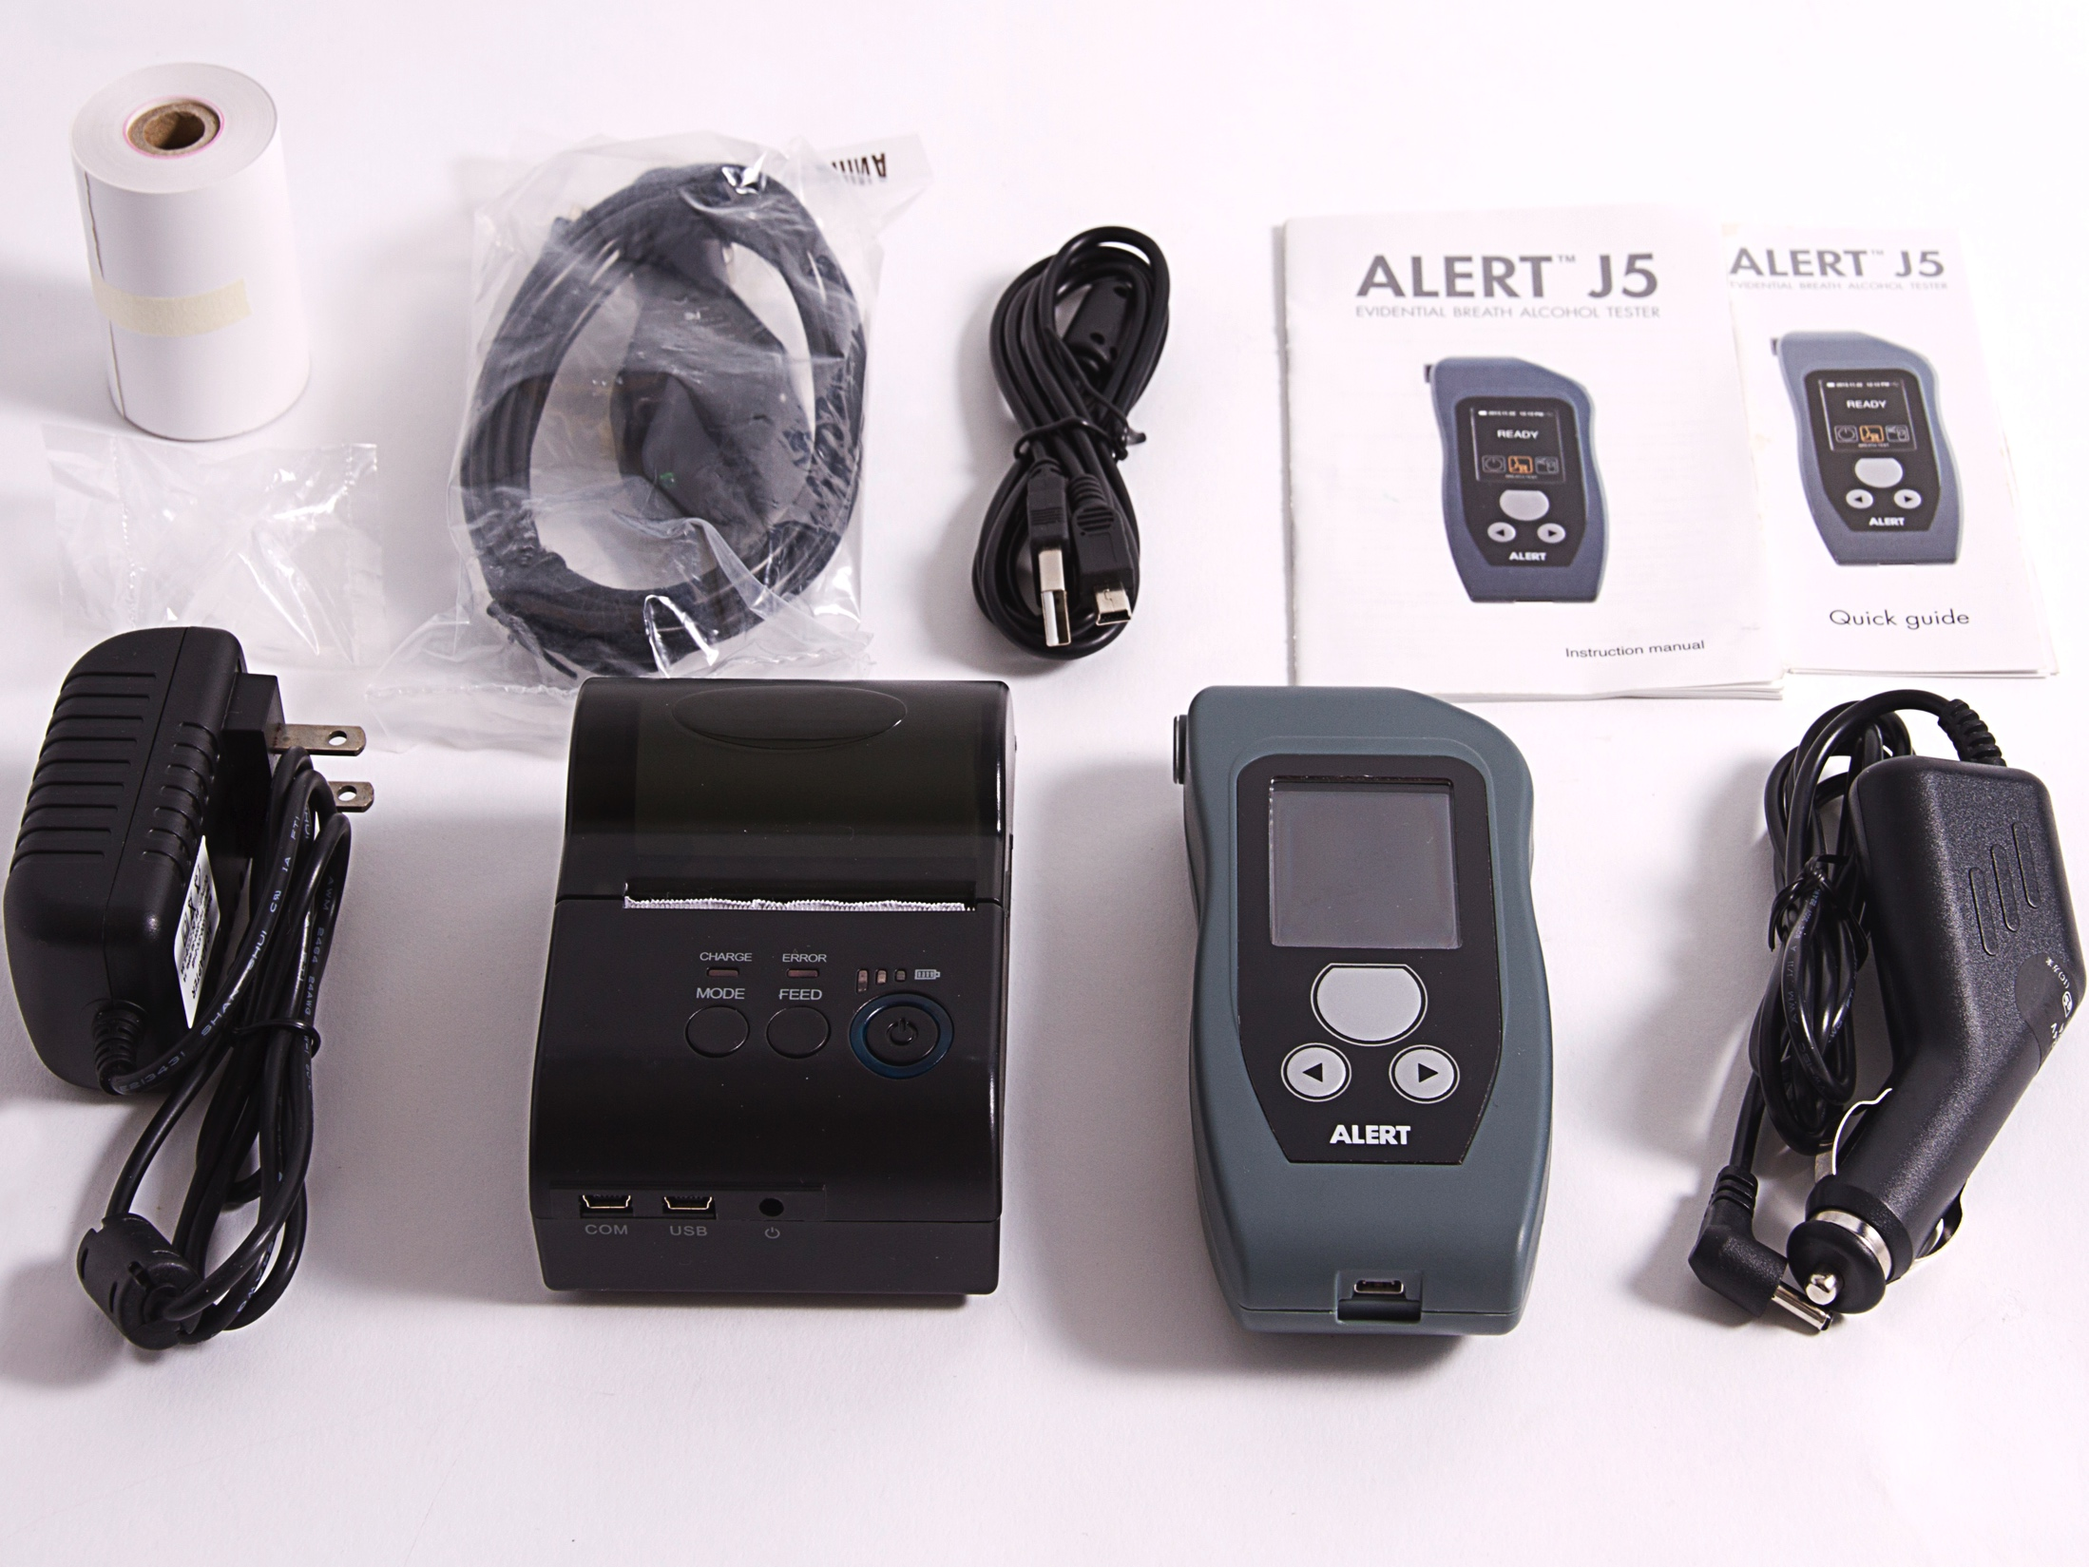
Accessories

Slide 54
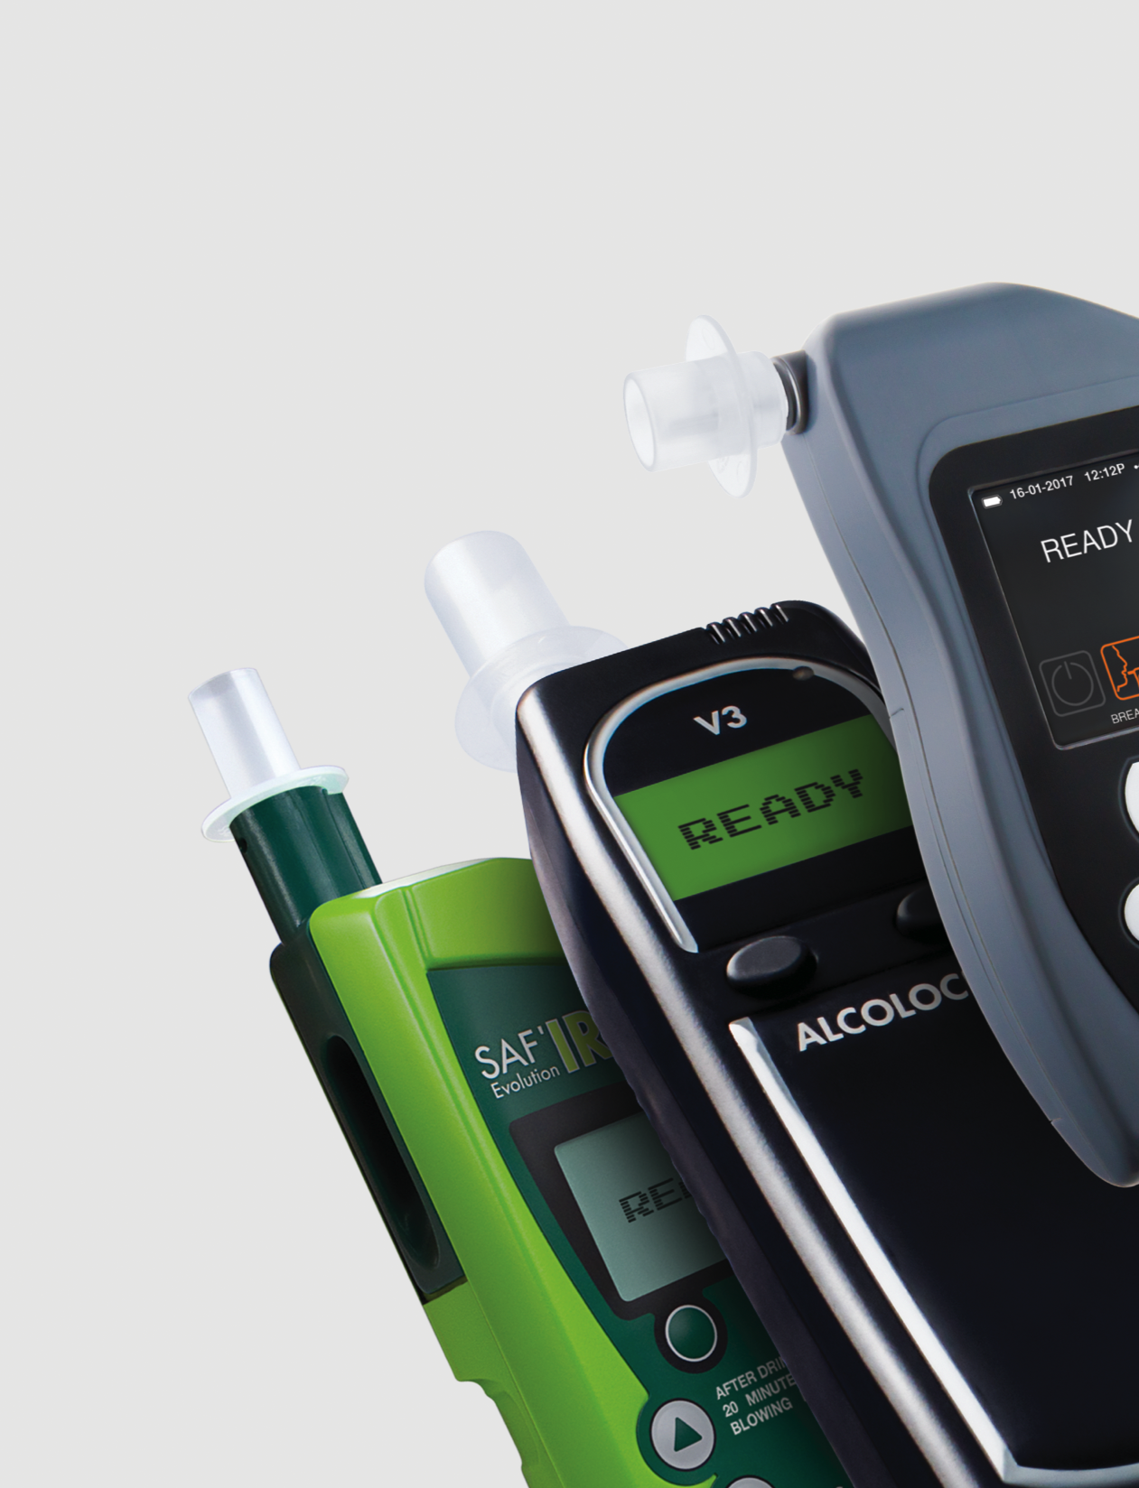
MOUTHPIECES

Slide 55
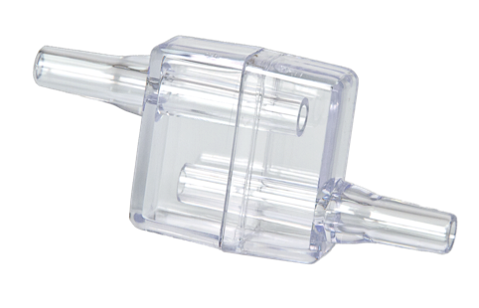
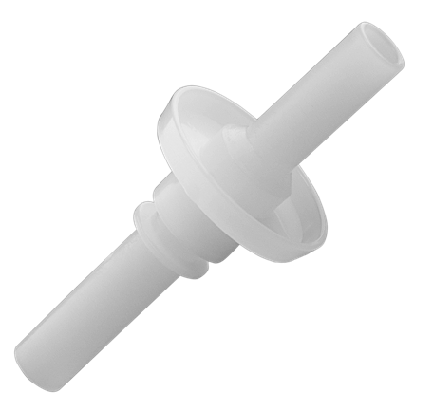
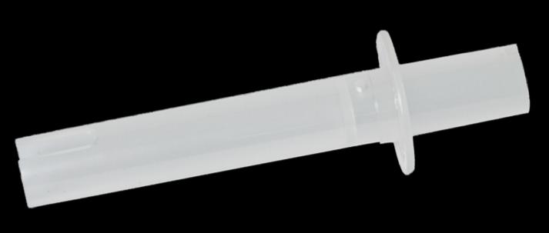
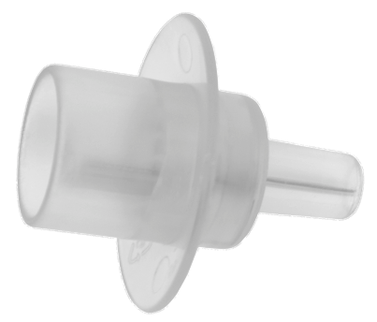
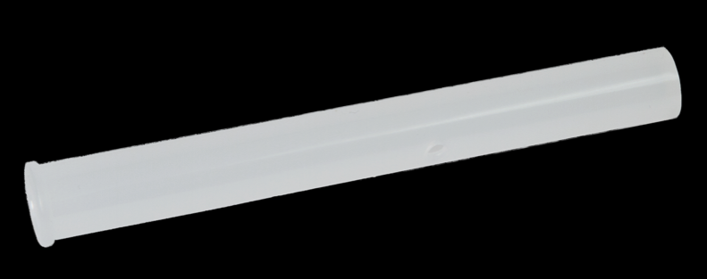



MOUTHPIECES
Accessories
Individually wrapped
Used in all ACS breath alcohol testers
Compatible with other breath alcohol testers
Square
ASIV
Saf’IR
R-Flow
Pressure tube
Oval
Round
Straight tube
55

Slide 56

SENSORS

Slide 57


SENSORS
Accessories
Electrochemical sensor technology
Detects the concentration of alcohol by means of a chemical reaction and measurement of an electrical current
Specific for alcohol detection with no response to ketones or hydrocarbons
Used by police officers, employers and other professionals
Mini sensor
Micro sensor
57

Slide 58



Certifications
ACS is proud of its operations and quality management.
We have achieved some of the industry’s best known quality management certifications.
58

