Slide 1
Corporate Overview
TBD
TBD@acs-corp.com

Slide 2
AGENDA

Slide 3
ACS. Overview
Our Vision
Alcohol Countermeasure Systems (ACS)
Canadian-based corporation established in 1976
Headquartered in Toronto, Ontario
Focused on the design, development and manufacturing of innovative breath alcohol testing technology and safety applications.
International sales and customer support:
USA
Sweden
France
United Kingdom
Hong Kong
Australia
Colombia
an extensive global network of authorized dealers.
To develop life saving innovations that keep people safe.
To be a world leader in promoting safety and preventing impaired driving

Slide 4
ACS. Operations
Mission
Serving multiple markets:
Law Enforcement
Regulatory / Compliance
Commercial / Public Fleet Management
Automotive OEM
Occupational Health & Safety
Personal safety
To research and develop high quality, user-friendly products with a strong commitment to environmental and social responsibility.
To improve global road safety through innovative design, manufacturing and customer support services.

Slide 5
ACS. People
Core values
Provide quality customer care
Focus on innovation and entrepreneurship
Embrace collaboration and cooperation
Strive for excellence and improvement
Contribute to community safety and well-being
Our Efforts Save Lives
Engineers
Research scientists
Technical design
Production
Customer support representatives
Accounting and finance
Sales and marketing
A proud and long-standing partner of global road safety organizations
Traffic Injury Research Foundation (TIRF)
European Transport Safety Council (ETSC)
Advocacy organizations
Mothers Against Drunk Driving (MADD)

Slide 6
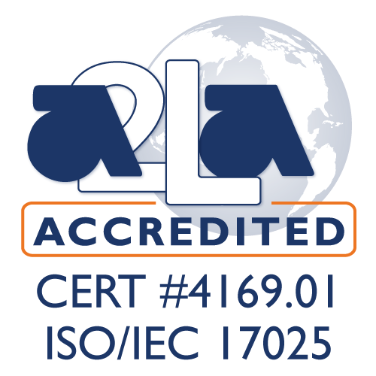
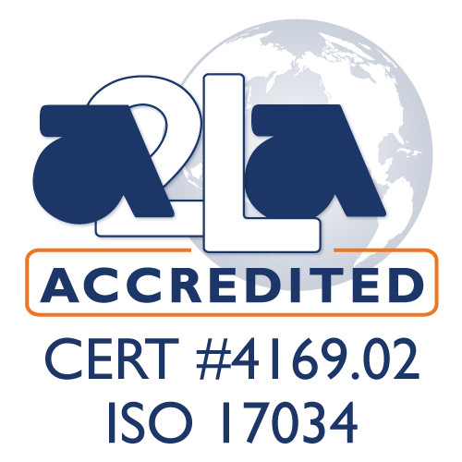
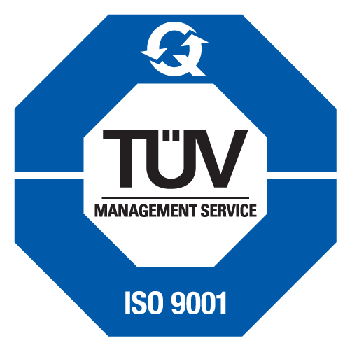
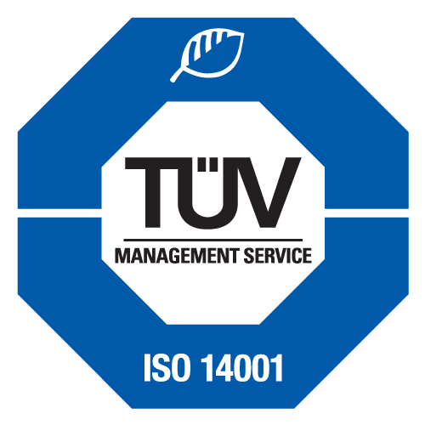
ACS. Quality
Offering internationally recognized manufacturing quality, our global operations are supported with industry leading product and service quality, and are certified to ISO 9001, ISO 14001, ISO/TS 16949, ISO 17034 and ISO/IEC 17025. Our commitment to safety, quality and customer service defines our industry leadership.
ACS and its affiliates are committed to maintaining the highest standards in:
the technology we develop
the products we manufacture
the services we provide
Our teams of dedicated employees surpass our quality objectives by:
continual improvement
superior levels of customer satisfaction and expectations
employee empowerment and accountability
dedication to excellence

Slide 7
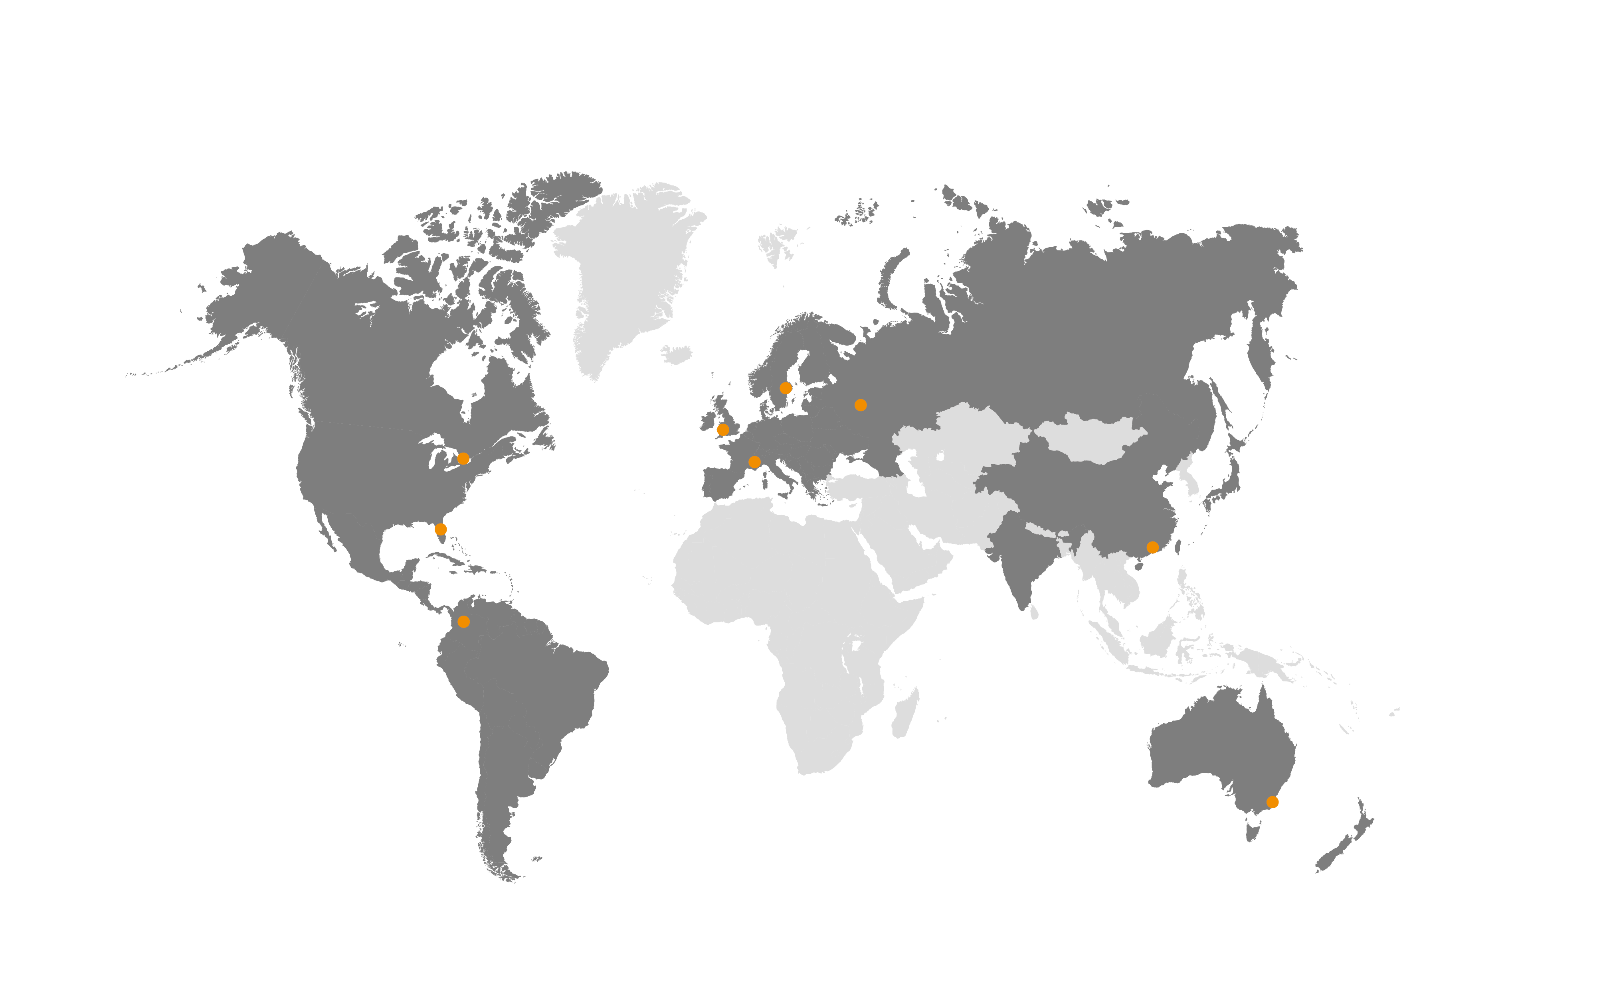
ACS. Locations

Slide 8
Certifications
ACS is proud of its operations and quality management.
We have achieved some of the industry’s best known quality management certifications.
8

Slide 9
Thank you!
Q & A
TBD
TBDy@acs-corp.com

